Slide 1

Thunderhead Replacement
Thunderhead Replacement
Change Type: Discretionary
Project Number: 4004035
Review Authority: Shared Services Technical Design Authority
Domain / CoE: Shared Services
Author: Niladri Dasmahapatra, Kishor Pathak
Lead Designer: Shashi Kiran Kerur
Key Milestone Date: TBC
Document Classification: Confidential
Full/Lite: Full
Review Date: TBC
Document Version: v1.0.5
Information Classification − Confidential
HLSD v3.21

Slide 2

Solution Design and Template Completion Guidance
Solution Design Guidance
The systems, processes and operating models are in place bank-wide to be able to successfully process zero and Negative Interest Rate products. For applications that handle interest rates, we must continue to ensure the application will not fall over if zero or negative rates are entered.
For applications that handle interest rates, if there is a proposed change requested, please ensure your application can handle zero or negative rates should they ever occur. We must ensure the application will not fall over if zero or negative rates are entered.
As part of the Negative Interest Rates Programme, a bank wide assessment was carried out across all the existing application to firstly identify the ones that have an interest rate element within them, secondly we identified the applications that required changes/enhancements so they could handle/tolerate zero or negative interest rates. These enhancements were all put in place.
Moving forward, we need to ensure that application changes or introducing new applications that deal with interest rates do not make a change which might undo or prevent zero or negative interest rates from working within the application.
Designers should consider NatWest Technology Principles while designing solutions.
Completion Guidance
This template is for the presentation of a proposed Solution Design to the appropriate authority Governing the Design
This document serves the full role of a High Level Solution Design for I2V purposes. To satisfy this role, it should meet the Quality Criteria given in the Appendix.
The main document should contain enough detail to allow the reviewing authority to understand:
The requirements
A list of key functions being delivered
A list of interconnected systems identified to deliver each function
The architectural changes being made
The system context diagram
How the design meets the requirements
The key design decisions made
The document should not contain any embedded design documents and should be complete in itself
Depending on the scale of the project and stage in the lifecycle, slides can be added based on the needs of the design. If a slide is not applicable then do not delete it, but make a brief statement to justify why it isn’t required.
Once approved by the Design Authority, this document should be added to ServiceNow project documentation for ORP and to feed into the Environment Design process.
Project must go through the Workload Placement Decision Tree (WPDT) at early stage to determine the most appropriate hosting location for the service.
When being used for a HLSD+-lite scenario then please complete as appropriate including, at least, sections marked with this symbol

Slide 3
Introduction: Engaged Design Areas and Feedback (1/2)
Design Area (Domain, CoE or Franchise) (Add additional domains, if required) | Platform(s) | Stakeholder approval/comments
CB |  | NA
RB |  | NA
NWM |  | Akshay Hardi, Amit Kapoor, Rahul Sharma
Data & Analytics |  | NA
Payments |  | NA
Core (including CES) |  | Lynne Hopkins - Existing endpoint to be consumed for statement address (CWStatementAddressAAA web service), and for CES events, Enterprise Service Platform (ESP) services to be consumed.
ESP |  | Lynne Hopkins - Existing cicscore services to be consumed for statement address (ContactPreferenceManagement), CES events (CommunicationManagement) and Customer CIN (CustomerArrangementManagement), through Enterprise Service Platform (ESP) web-services.
Enterprise Engineering | API(APIGEE) | Namespace & API’s are approved. Sandbox environment is created
 | IAM | Lavanya Jayachandran, Adithya Maddur, Mukundhan Santhanam, Balamurugan Murugapperumal - Reviewed the design & validated the pattern. FSSO design is ok. Self Service been suggested during execution. WIAM07 suggested. [IADSPED-63479] Letters - EE Tools JIRA (rbsgrp.net) Both 2CP & MPDC must be onboarded to IAM
 | ECM | Ian Croom, Tim Cain, Rajiv Garg, Syed Naqvi - Reviewed the design, the recommendation is to use ECM EC1 instance which is on strategic PnF platform.
 | BAS | NA
 | Other (Ops, Risk & Security, Architecture) | NA

Slide 4
Introduction: Engaged Design Areas and Feedback (2/2)
Design Area (Domain, CoE or Franchise) (Add additional domains, if required) | Platform(s) | Stakeholder approval/comments
Risk |  | NA
Security Architecture (CoE) | Security | Jason Muir - Reviewed the design & validated patterns. No security concern in design. Security assessment Kellie Higgins : Security assessment in progress PenSec Testing – In progress
Operational Resilience |  | Alan Steedman - Reviewed the design. Resilience design looks good. The solution deployment would follow “Release Records” process.
Hosting Solutions |  | Julian Clements – Design reviewed, and all components already gets used in Bank and not introducing any new component. WPA1 approval is sufficient to provision non production environment. WPA2 would be required for production environment. VPC Endpoints are used for egress traffic
Finance |  | NA
HR |  | NA
Any other domain/area engaged |  | NA
Platforms in the context of this slide are Application, Feature or Infrastructure teams responsible for the design and delivery of constituent components of the Solution. Please include all platforms that are impacted, adding new rows where needed. All impacted platforms need to be syndicated prior to submission to the Design Authority and their approval to, or comments on, the design proposal noted.
For Design Areas not impacted, please mark as n/a.

Slide 5
Governance History
Domain Technology Roadmap
Version | Board | Decision or N/A | Date | Link to meeting minutes, Changes, Issues and Actions summary
 | Technology Design Authority
 | Architecture Review Meeting
Design Review
Version | Board | Decision | Date | Link to meeting minutes, Changes, Issues and Actions summary
N/A | Workload Placement Authority (WPA2) | WPA Stage 2 Conditional Approval | 15/12/2022 | WPA2 - ISEP-48137
N/A | Core Design Authority | Approved | 13/12/2022 | Core DA MOM
N/A | Workload Placement Authority (WPA) | Approved (Stage 1) | 10/02/2022 | Workload Placement Authority (WPA) Catalogue Ref WPDT-2022-037
N/A | CTO Review Board (CTORB) | Recommended for WPA Approval (Stage 1) | 08/02/2022 | Workload Placement Authority (WPA) Catalogue Ref WPDT-2022-037
For HLSD+ Lite complete this page for original design and add row for the ‘Lite version’ of the HLSD+
Notes:
Only once the review done.

Slide 6
HLSD+ Document Version History (1/4)
Version | Date | Reviewers | Changes, Issues and Actions summary
0.1 | 26-AUG-2022 |  | Base Version
0.2 | 27-OCT-2022 | Lavanya Jayachandran, Adithya Maddur, Mukundhan Santhanam, Balamurugan Murugapperumal | Authentication of internal users then SAML based is possible .for MS call to app then we have a different pattern for which app is using Apigee.(App does not want IAM pattern here). SAML response does not have any life time its a synchronous call. If SAML used then Letters app is service provider for IAM.
0.3 | 02-NOV-2022 | Neil Alexander | Changed platform name to Customer Composition Platform. LA changed to CCP, CCM Services changed to CS and Compositions Services changed to CCS
0.4 | 03-NOV-2022 | Shared Services Team | Implemented review comments. Updated slides 12, 16, 18, 24
0.5 | 07-NOV-2022 | Neil Alexander | Implemented review comments w.r.t email titled “Shared Services Design Peer Review Session”
1.0 | 13-Dec-2022 | Core DA | Approved by Core DA. Baseline version.
1.01 | 21-Jul-2023 | Design Team | Updated slides 1 – Updated project number from 4003191 to 4004035. Updated author names 3 – Added ESP & APIGEE latest status 4 – Updated Security & Pentest status 4 – Updated Hosting Solutions Status - Added VPC Endpoint is used for egress traffic

Slide 7
HLSD+ Document Version History (2/4)
Version | Date | Reviewers | Changes, Issues and Actions summary
1.01 | 21-Jul-2023 | Design Team | 5 – Added previous WPA2 status 9,11 – Added MPDC, SFTP 12 – Added AEM & CACI as Out-Of-Scope 13 – Removed unused patterns, IP002, IP003, SP012, SP013. Added APIGEE pattern 16 - Creation and maintenance of Roles and permissions - Maintenance of roles should be via SLX onboarding and authorization shall be done within Communication Composition Portal (CCP) 17 – Updated templates count (189) to in-scope. Added AEM, CACI, Remaining Thunderhead templates to out-of-scope 19 – Updated diagram. Added SFTP to GSS for Printing. Added fetch Customer CIN based on sort code & Account Number Core API for future usage 21 - Modified Diagram. Removed CACI & AEM 22 – Added CIN based on sort-code & account-number API to Core-system scope for future usage 25 – Updated Diagram with CloudWatch 26 – Removed narrative regarding using mTLS for m/s communication, mTLS is not used for intra m/s communication except for those required for SSO/FSSO

Slide 8
HLSD+ Document Version History (3/4)
Version | Date | Reviewers | Changes, Issues and Actions summary
1.01 | 21-Jul-2023 | Design Team | 29 – Updated diagram and added GSS. License Manager details updated. Removed unused patterns IP002, IP003, SP12, SP13 37 – Updated Infra diagram with added/modified components 40 – Removed DR. Hide slide. Added comment to query 41 – Removed UAT. Hide slide 42 – Added API management 45 - Removed unused patterns IP002, IP003, SP12, SP13 46 & 47 – Updated 2CP MP SSO Sequence diagram 52 – Added GSS for file transfer 53 - Added AWS ALB, Istio Ingress with AWS ALB,AWS ALB Ingress controller, APIGEE, API Gateway, Removed Route53 55 – Added S3 for backup/restore 62 – Added AEM DAM Integration to future roadmap 65 – Added APIGEE sizing limit 65 – Updated AEM impact description on design 66 – Updated MP Bank cloud component availability and compatibility for Kubernetes environment 68 – Added Open Risks
1.02 | 20-Sept-2023 | Design Team | Slide 12: Updated scope to include DLP Slide 13, 45: Added VPC endpoint details Slide 35: Added data retention details Slide 48: New to cover security aspects of APIGEE & API Gateway Slide 53 : Added comms between MP PM & MP SaaS Slide 54: Updated Sefas & Data centre resiliency Slide 61: Added for VPC endpoint decision
1.03 | 26-Sept-2023 | SS Design team | Slide 11: Added DLP & VPC to Glossary Slide 62: Updated APIGEE as the tactical solution Slide 68: Added VPC Endpoint as a risk as it's not DLP compliant

Slide 9
HLSD+ Document Version History (4/4)
Version | Date | Reviewers | Changes, Issues and Actions summary
1.0.4 | 10-Jan-2024 |  | Slide 14: Removed pattern PR007-SMA-02 related to APIGEE Slide 20: Removed APIGEE in the context diagram Slide 22: Updated diagram to remove APIGEE Slide 26: Updated diagram to remove APIGEE Slide 30: Updated diagram to remove APIGEE Slide 43: Removed APIGEE related details Slide 44: Updated details for WAF Slide 48: Removed slide on API Gateway & APIGEE as it's not relevant Slide 53: Removed APIGEE details Slide 61: Added new decision for Ingress Slide 62: Removed APIGEE as tactical solution Slide 65: Removed assumption A12 related to APIGEE Slide 68: Removed Risk R2 related to APIGEE
1.0.5 | 29-10-2024 | SST Design | Slide 39, 40: New slides to depict MP EKS cluster configuration details of Minimum hardware specifications Slide 38, 41: Updated to reflect MP EKS configuration changes Slide 62: Updated decision on AZ resiliency changes

Slide 10
Glossary - 1\3
Term | Definition |  | Term | Definition
AFP | Advanced Function Printing an IBM architecture and family of associated printer software and hardware that provides document and information presentation control independent of specific applications and devices. |  | MP / MPDC | Messagepoint / Messagepoint Dot com SaaS based customer communication and template management software
PDF | Portable Document Format is a file format for capturing and sending electronic documents in exactly the intended format. |  | MP Connected | Messagepoint Connected is an Interactive module that allows users to request and send individual customer communications on an “as-required” basis
VPF | Virtual Page Format is an internal file format used by Sefas unique normalization engine that converts all pre-composed documents into a single Virtual Page Format (VPF) that combines composition and post-composition to optimize production and distribution |  | CCM | Customer Communication Management is a way for organizations to create, manage, and deliver customer communications across multiple channels such as printed documents over mail, emails, SMS, web pages, fax etc.
ECM | Enterprise Content Management is the bank’s Strategic Document Repository capable of handling high volumes of documents and records from multiple applications and has an integrated records management capability |  | Touchpoint | A touchpoint is one type of business communication to a defined audience within Messagepoint.
2CP | Communication Composition Platform |  | DMH | Document Management Hub
CCP | Communication Composition Portal |  | PCC | Paragon Customer Communications. A print service provide responsible for printing documents
CS | Communication Services |  | PSP | Print Service Provider manages a company’s document output
CCS | Communication Composition Services |  | NWB | NatWest Bank
MI | Management Information |  | SI | Secure Inbox

Slide 11
Glossary 2\3
Term | Definition |  | Term | Definition
SaaS | Software as a Service is a software licensing and delivery model in which software is licensed on a subscription basis and is centrally hosted. See also Wikipedia |  | PPD | Page Piece Definition is optional piece info entry in a page object or form dictionary that can hold a page-piece dictionary containing private application data associated with a PDF page or a form XObject. Application can use this store has a private data which can convey meaningful information to the application
Docker | Docker is an open-source containerization platform. It enables developers to package applications into containers i.e., standardized executable components combining application source code with operating system (OS) libraries & dependencies required to run that code in any environment |  | TLE | Tag Logical Element (IBM AFP Structured Field). TLE structured fields as part of its indexing process, or it can receive these structured fields from the input print file
EKS | Elastic Kubernetes Service (Amazon EKS) is a managed Kubernetes service that makes it easy to run Kubernetes on AWS without needing to install, operate, and maintain Kubernetes control plane or nodes |  | RTO | Recovery Time Objective describes the interval of time that might pass during a disruption before the quantity of data lost during that period exceeds the Business Continuity Plan’s maximum allowable threshold or “tolerance.”
ECS | Elastic Container Service (Amazon ECS) is a highly scalable and fast container management service. You can use it to run, stop, and manage containers on a cluster |  | RPO | Recovery Point Objective describes the interval of time that might pass during a disruption before the quantity of data lost during that period exceeds the Business Continuity Plan’s maximum allowable threshold or “tolerance.”
GSS | Generic Solution Service is server hub which acts as the ingress/egress for all 3rd party file transfers |  | IAM | Identity and Access Management

Slide 12
Glossary 3\3
Term | Definition |  | Term | Definition
FSSO, F-SSO, or SSO | Federated Single Sign On |  | ESP | Enterprise Service Platform is a middleware, which works behind the scenes to aid application-to-application
AEM | Adobe Experience Manager is an enterprise-grade Content Management System (CMS). |  | CSP | Cloud Service Provider
DAM | Digital Asset Management is a software and systems solution that provides a systematic approach to efficiently storing, organizing, managing, retrieving, and distributing an organization’s digital assets. |  | CMOD | Content Manager OnDemand is an IBM product which supports the high-volume batch capture, storage, and retrieval of documents.
SLX | ServiceLine Express |  | HCS | Harmonie Communication Suite SEFAS HCS is ECP - Enterprise Communication Processing software
C:D/S+ | IBM Connect:Direct Secure+ is the NWG strategic file transfer tool. |  | ECP | Enterprise Communication Processing
AD | Active Directory |  | ECM | Electronic Content Management
EE | Enterprise Engineering |  | EC1 | Electronic Content Management Cloud One
PPD | Page Piece Dictionary |  | MPPM | Messagepoint Production Manager is an orchestration system that is hosted on Natwest private cloud.
SFTP | SSH File Transfer Protocol (also known as Secure File Transfer Protocol or SFTP) is a network protocol that provides file access, file transfer, and file management over any reliable data stream |  | VPC | Virtual Private Cloud AWS VPC
DLP | Data Loss Prevention

Slide 13
Project Background & Scope: Business Requirements
Background
Thunderhead (Interview NOW) and Letters application is an interactive web-based system for use by NatWest (RBSG) operational staff to create outbound letters with capability to deliver outbound letters channel, template management and document composition and production fulfilment of letters through Sefas. Thunderhead is end of life and is on sell list and Letters has limited capabilities.
Thunderhead/Letters Application (LA) is document template management tool with capability to produce electronic and paper communications when an element of human interaction is required to produce the document, or automated emails (for example, complaint handling letters, Act Now Alert emails) with the facility to create and despatch 1 million customer letters per annum.
Scope:
Design scalable and flexible solution which enables capability for wider CCM and deliver the migration of interactive templates (including enclosures).
1425 templates and Brand in scope
NWB, RBS, UBN, UBR, Offshore brands (RBSI, NWOJER, NWOGUE, NWOIOM, NWOGIB, IOM)
Documents to be ingested in Archival and available for Business to retrieve through ECM portal
Local & Central printing of documents
Management Information (MI) Reports
Customer events capture
Teams & user maintenance
As the application deals with Customer confidential information (Customer Name & Address) the intended solution must be DLP complaint in scenarios where data is transferred to external application / service
Out Of Scope:
Email Templates - AEM is strategic email option
Email communication to customers - AEM is strategic email option
Data migration
Central Digital Assets storage integration with Adobe DAM (Adobe Experience Manager)
CACI for mail sorting
MoSCoW (must have, should have, could have and will not have) detailed business requirements, please refer appendix slides
Notes:
What business areas, business services and brands are affected by this change e.g. RBS, NWB, UBN, UBR?
What are the high-level Business Requirements for this Solution?
These requirements should include brief descriptions of:
New functionality being introduced
Business critical functionality e.g. Payments changes
Reporting functionality
Any specific legal or regulatory requirements
Other relevant requirements (i.e. Accessibility and compliance to the RBS Accessibility Standards under the Equality Act 2010, DLP, etc.)
Does the solution design adhere to the appropriate Technology and local architectures and technical standards?

Slide 14
Delivery Scope: Non-Functional Requirements
Capacity and Performance
Userbase of approximately 2500 users over multiple locations
49 to 65 concurrent communication orders totalling 7,800 daily (after 30% increase from current 38 to 50 concurrent users)
End to end letters volume 975 to 1,300 per hour for 6 to 8 business operational hours per day
Minimum 250k letters per month
Peak volume created - 1 million customer letters annually for business areas across the NatWest Group.
Pattern/Standard Reference | Pattern/Standard Name | Pattern Status
WIAM-07 | Federation to SaaS Apps | Approved
IP400 | Federated Identity & Access | In Service
SCP_056 | UCS - Secure consumption of a 3rd party SaaS service | Approved
SCP_046 | FDN - Federated Single Sign On | Approved
SP031 | File Transfer internal to NWG | Approved
SP032 | File Transfer external to NWG | Approved
VPC Endpoint | AWS product to establish connection with third party service using private link | Approved

Slide 15
Delivery Scope: Non-Functional Requirements
Acceptable Maintenance Windows
Time Zone​ | Weekdays​ | Saturday​ | Sunday​ | Bank Holiday​
UK​ | ​n/a | n/a | 0000-0400 | n/a
Operational Hours​
Time Zone​ | Weekdays​ | Saturday​ | Sunday​ | Bank Holiday​
UK​ | ​0001-2359 | 0001-2359 | 0401-2359 | 0401-2359

Slide 16
Delivery Scope: NFRs - Resilience Requirements
IT Resilience policy compliance is a mandatory requirement for all new and changing Service Elements – Delivery Scope: Resilience requirements on page 10 must be completed in full. Contact: ~ Resilience & Continuity, Resource & Demand for support.
Have the resilience requirements been approved by the Business Service owner or approved delegate | Yes
Name of the Business Service owner or approved delegate Tier 1 & 2 Asset List | Karen Clark
Business Service Resilience Tier | Tier 3
If Tier 1 or 2 provide: Service Name | NA
If Tier 1 or 2 provide either: Service Element Name from Tier 1 & 2 Asset List NEW Service Element Name | NA
RTO (days, hours, minutes) | 24 hours
RPO (days, hours, minutes) | 24 hours
Describe resilience and continuity requirements for:​
DR Recovery Time objective <= 24 hours; DR Recovery Point objective <= 24 hours.
System to be highly available as per operational hours. Any scheduled downtime for maintenance is agreed in advance and outside core operational hours.
SLA support & maintenance with third party - technology must bring system up within 24 hours
IT Application is used to describe the business software and all supporting infrastructure software and hardware that process, transmit or store bank information. This includes and is not limited to: Hardware, including servers, desktop PCs, laptops and other portable and hand-held devices; Software, including bespoke applications, and office productivity suites; Databases, including enterprise information systems; storage devices, such as hard disks, tapes and removable media; Bank IT networks, including devices such as routers, switches gateways and firewalls, and also including telephony and conferencing systems, network cabling and access points. New SD&OR Operational Resilience Framework asks only for an RTO and RPO to be proven (please see page 8 of NatWest Group Operational Resilience Framework pdf).

Slide 17
Delivery Scope: NFRs - Security Requirements
The design project must seek to meet the Overarching Security Design Principles by listing the control requirements the design will consider and how they will be meet.
These requirements can be self-served from pre-defined Security Control Patterns and High-Level Requirements lists, or supplied from your assigned security consultant on the project.
Data Classification | Confidential
Rating Value | C | I | A
 | 2 | 2 | 2
ServiceNow ISBIA Reference | BIA0020748
Describe this project’s specific business requirements that are in addition to the standard security controls that apply to all solutions:
User authentication and user authorisation
Colleague authentication will be through Federated Single Sign On. Authorisation to access specific functions within the Communication Composition Portal (CCP). FSSO is managed from within 2CP application. User redirection is used to achieve seamless integration between Communication Composition Portal (2CP) and Messagepoint Dot Com (MPDC)
Communication between microservices of same application must be secured.
Communication between microservices of different application must be secured.
- No customer access to Communication Composition Portal (CCP).
Customer identification (KYC, KYB, Anti-Money Laundering) – N/A
Creation and maintenance of Roles and permissions - Maintenance of roles should be via SLX onboarding and authorization shall be done within Communication Composition Portal (CCP)
Payment security and associated security controls – N/A
Fraud prevention and monitoring & alerting – N/A
Impact of regulatory requirements (e.g. PCI) – N/A
Network environment placement – Colleague access to the solution must be available from EUROPA domains

Slide 18
Phasing Overview
This target solution will be implemented in a staggered manner covering multiple phases. The scope of this design is to meet the objectives of Phase 1 and flexible to scale and onboard phase 2.
Phase 1 | Phase 2
The objective is to stand-up the foundation for a one bank CCM solution while addressing the immediate need to replace the current Thunderhead based Letters application. This project will focus on building a new interactive Communication Composition Portal (CCP) using capabilities provided by Sefas & Messagepoint with capability to extend to other CCM services in the future. The aim for phase01 is to make the design extensible for further use cases, but if further changes are identified upon closer analysis then it shall be taken in phase-02.This scope will only cater for existing thunderhead templates migration to new platform. Migration of 189 thunderhead templates to CCP Communication Composition Portal Role based Access to features and templates User can assign themselves to a team Print PDF document locally Auto brand based on sort code Cancel letter queued for print Details for auto feed Interview screen for information capture Central print dispatch at set time Asset version control Common elements can be shared across templates Style sets per brand Archive and retrieval of digital communication (batched) Basic Management Information (MI) Reports | The objective is to identify & onboard new business use-case bank wide for any CCM related requirements to align with one bank initiative. Bereavements NatWest Market Customer Lending Customer Engagement Portal Credit Card / Statements Management Information (MI) to DataMart Archival & Retrieval through Communication Services (CS) API Centralized Digital Asset Management (DAM) via Adobe Experience Manager AEM Remaining Thunderhead templates migration to CCP
* Refer appendix for detailed list

Slide 19
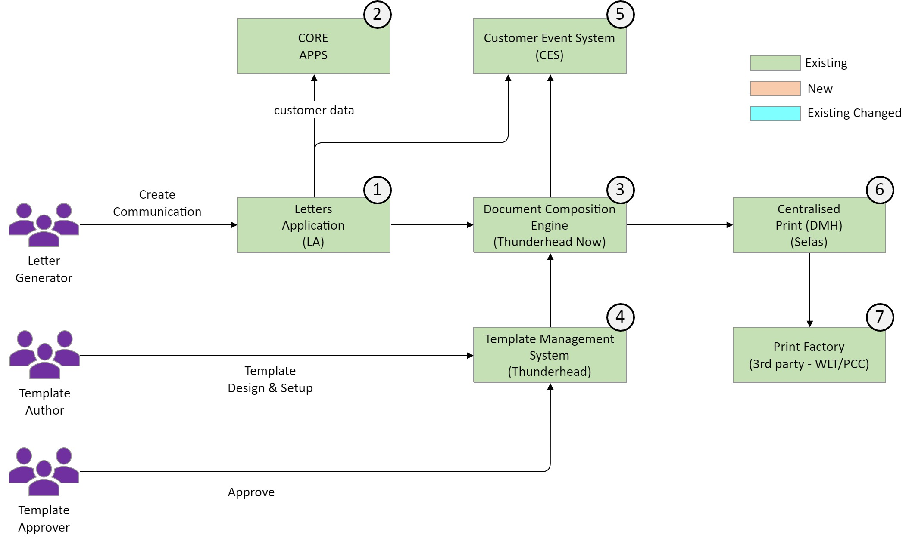
System Context – ASIS
Letters Application (LA): This is an application to allow NatWest staff to send letters using the Document Composition Engine
CORE APPS : Bank’s inhouse web service used by LA for fetching customer details like address, brand etc.
Document Composition Engine (DCE): This is the heart of the letter generation process. It takes supplied business information, matches it to a selected letter templates and renders a letter – either for preview (as a PDF) or for centralised printing by Group Document Services (as AFP). It is based on the Thunderhead Now package
Template Management System (TMS): This provides the business with the ability to edit and manage the letter templates. This includes template creation, layout design and a managed approval process. It's mainly used by template authors and approvers
CES : Bank’s inhouse web service used for logging CES event for local print and updating CES event for letter cancellation
Centralized Print (DMH) : The LA submits letters for printing to DCE. DCE will further send the letters for printing to DMH
Print Factory (PCC/WLT) : Print vendor where files are actually printed and dispatched to customers address
Notes:
Include a System Context Diagram. This should describe the context of the solution, and should not attempt to describe the design, technologies used, or integration methods and protocols.
What systems does the solution interact with and which are changed?
What user groups does the system interact with?
What are the boundaries of the solution?
Need to reflect the Service element dependencies showing where there are linkages and inter dependencies i.e. 3rd Party infrastructure or NatWest infrastructure (touch points with existing CCS (tier 1 & 2) systems & services)
If relevant, include notes on the business process context.

Slide 20
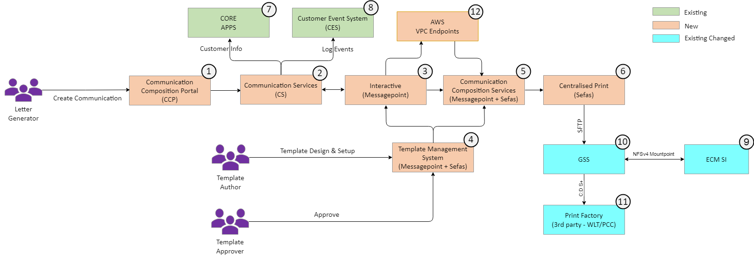
System Context - TOBE
Communication Composition Portal (CCP): ReactJS based web application to allow NatWest staff to send letters using the Document Composition Engine.
Communication services (CS): Microservices to establish a reusable interface between Communication Composition Portal (CCP), Messagepoint & External APIs (Bank & Non-Bank)
Interactive (Messagepoint): Messagepoint Connected interactive component on MPDC responsible for interactive experience for letter generators.
Template Management System (Messagepoint + Sefas): This provides the IT an ability to edit and manage the letter templates. This includes template creation, layout design and a managed approval process.
Communication Composition Services (CCS): Its responsible for communication composition through MP Production manager & Sefas engine.
Centralised Print: Sefas Producer to consume all communication generated during the day for final fulfilment, Post compose documents and SFTP to GSS. GSS transfer files to PCC for final printing
Core Apps: Bank’s inhouse web service used by Communication Composition Portal (CCP) for fetching customer details, log CES events, and fetch Customer CIN based on sort code & Account Number.
CES: Bank’s inhouse web service used for logging CES event for local print and updating CES event for letter cancellation
ECM SI: Enterprise content management Secure Inbox system to archive batched documents. Retrieval is through ECM SI Portal only.
GSS : Files generated by Sefas producer are SFTP’ed to GSS for transfer to print service provider (PCC)
Print Factory (PCC/WLT) : Print vendor i.e. Paragon Customer Communications (PCC) where files are actually printed and dispatched to customers address
VPC Endpoints – AWS service to establish secure communication between MPDC & Messagepoint Production Manager for bundle delivery
Notes:
Include a System Context Diagram. This should describe the context of the solution, and should not attempt to describe the design, technologies used, or integration methods and protocols.
What systems does the solution interact with and which are changed?
What user groups does the system interact with?
What are the boundaries of the solution?
Need to reflect the Service element dependencies showing where there are linkages and inter dependencies i.e. 3rd Party infrastructure or NatWest infrastructure (touch points with existing CCS (tier 1 & 2) systems & services)
If relevant, include notes on the business process context.

Slide 21
Design: High Level Solution Design – As Is
Document Composition Engine (DCE): This is the heart of the letter generation process. It takes supplied business information, matches it to a selected letter templates and renders a letter – either for preview (as a PDF) or for centralised printing by Group Document Services (as AFP). It is based on the Thunderhead Now package
Letters Application (LA): This is an application to allow NatWest staff to send letters using the Document Composition Engine. It is an NatWest developed application that makes use of components that are provided by Thunderhead for use with Thunderhead NOW.
Template Management System (TMS): This provides the business with the ability to edit and manage the letter templates. This includes template creation, layout design and a managed approval process.
Notes:
What is the current state for the High Level Solution Design ?
This is a single slide diagram of the As Is state for the design. It should:
Identify all existing systems involved in the change
Identify all existing interfaces between systems
Summarise the technology stacks currently used
Designers must include colour key/legend across design clearly describing what the component colours used in the diagram means.
May not be required if the design is new or not substantially changes and the following slide shows changed and new components.

Slide 22
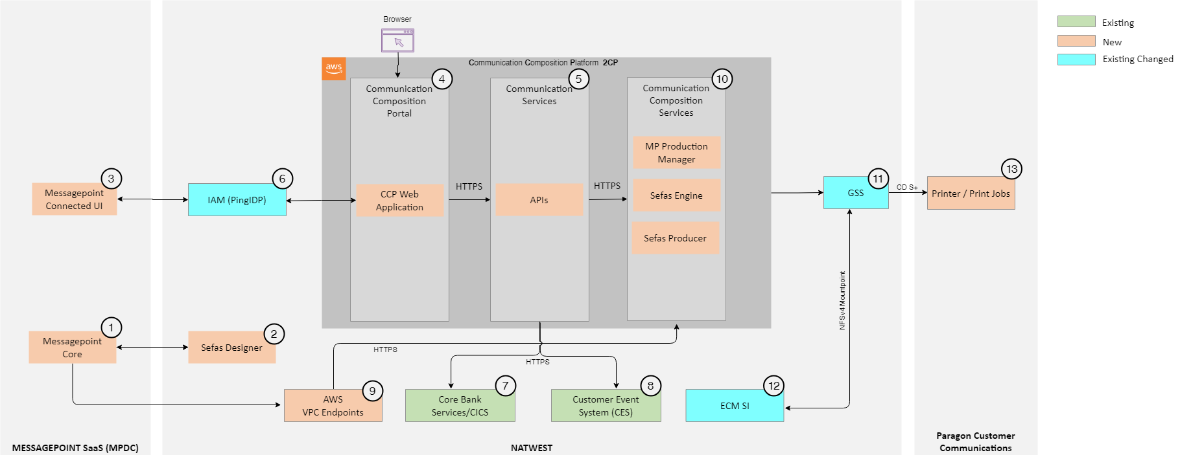
Design: High Level Solution Design – To Be (1/2)
Notes:
What is the target High Level Solution Design for this Solution?
This is a single slide diagram of the To Be design. It should:
Identify all systems being changed, added or removed / decommissioned
Identify all new and changed interfaces between systems
Summarise the technology stacks involved, highlighting any new products, frameworks or technology adoption
This slide should make clear what is new, what is changed and what is existing. Designers must include colour key/legend across design clearly describing what the component colours used in the diagram means.
Further details of the design should be covered in subsequent slides, but this slide should attempt to capture the main essence of the design.

Slide 23
Design: High Level Solution Design – To Be (2/2)
Messagepoint Core – Messagepoint Core, a SaaS/Web based solution to design touchpoints, manage content. It’s a part of Template Management System (TMS)
Sefas Designer - Developers use on-prem Sefas HC designer to create Master Templates & Layouts. The approved design is stored into design repository. It’s a part of Template Management System (TMS)
Messagepoint Connected UI – Messagepoint Connected is a cloud-based, Interactive Communications solution that enables front end users to quickly personalize, request approvals for (if required) and send communications to customers via print channel.
Communication Composition Portal (CCP) - Web application to allow Bank staff to send letters using the Messagepoint (new SaaS product) Interview screens and Sefas. Application to be built using React Framework.
Communication Services (CS) - Multiple Spring Boot microservices serving CCM business functionalities
IAM (PingIdP) – Bank’s Identity provider for FSSO authentication for 2CP & Messagepoint
Core System – Bank's backend web-services that provides customer address, brand, CIN based on sort-code & account-number
CES – Customer Event System is bank's centralized solution to capture customer events and logs
VPC Endpoints – AWS Service used for ingress communication between MPDC and Messagepoint Production Manager (MPPM) to download job bundles and process order
Communication Composition Services (CCS) - Product services to be consumed by Communication services (CS) to compose, post compose and perform downstream operations on the customer communication.
Messagepoint Production Manager (Content Composition)
Sefas (Engine/Composition, Producer/Post Composition)
GSS – Bank’s native solution for any internal or external file transfer
ECM SI – Enterprise Content Management is bank's archival repository. This
Print Factory – Paragon Customer Communications (PCC) print service provider (PSP) to receive print and related metadata files for fulfilment

Slide 24
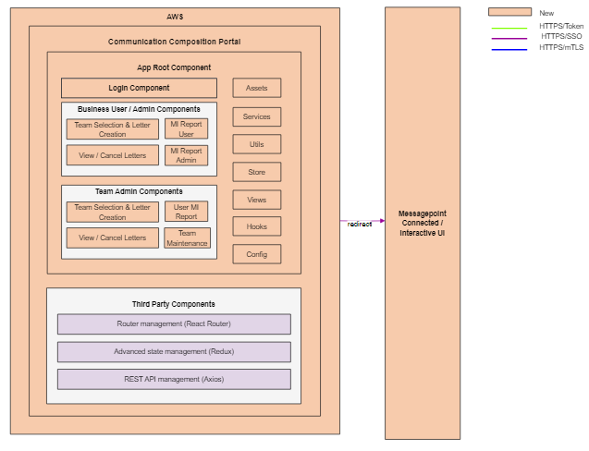
Design: Communication Composition Portal – 1/2
Communication Composition Portal :
Since containerisation is the bank’s strategic approach, a new Lightweight React JS web app will be designed, containerized and orchestrated through AWS EKS
Common landing interface for all support users to provision
Bespoke experience through federated single sign on using WIAM-07 pattern
Bank webservice routing based on sort code
Brand profiling (including auto touchpoint routing, user profiling)
Prefill Interview fields based on brand and customer data
Delete documents before print.
View last 7 days history
Generate Management Information (MI) reports
Data Persistence
Audit data and some MI details.
Staff related details.
Team details
Team assignment & Team Maintenance
Users, groups & permissions
Documents will be stored in ECM SI with record management through ECM SI (max 10 years)

Slide 25
Design: Communication Composition Portal Overview – 2/2
The main component of React application is the App Root component. This component connects all components and views.
App Root component invokes nested login component. The user is allowed into the application through SSO via PingIdentity.
Views module contains application's web pages.
Services module contains functions to interact with external API resources.
Utils module contains reusable function snippets for performing quick tasks like text truncation or down casing.
Store module houses state management files, such as Redux, which are used to make certain functions and variables available throughout Communication Composition Portal (CCP).
Hooks module contains codes and logic that can be reused across multiple components.
Config module contains application configurations like date format, default language, some master data set.
Communication Composition Portal (CCP) will use third party components for specific purpose such as routing, state management, REST API calls to bank CCM services etc.
Notes:
Light weight React JS Communication Composition Portal (CCP) will be built with ocker images and deployed as Kubernetes pods. The pods shall be configured for auto-scaling based on the metrics (CPU and memory utilization)

Slide 26
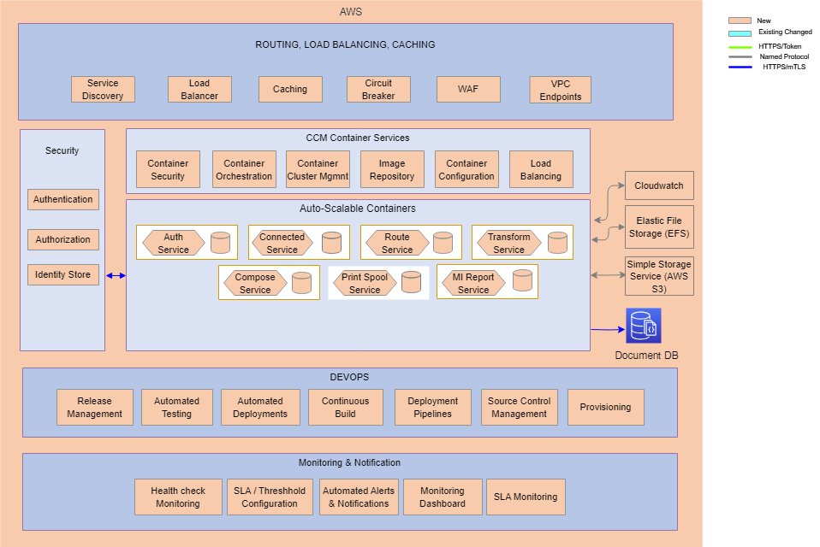
Design: Communication Services - 1/2

Slide 27
Design: Communication Services - 2/2
Bank Communication Services Key APIs:
AUTH API - Service to authenticate user, profile, and support SSO. Auth service will provide the authentication and authorization services for the user to login into the application and to see features based on assigned user roles. PingFederate identity provider is used to accomplish this task.
CONNECTED API - Service to invoke Messagepoint cloud API for orders, invoke route service to fetch customer data, invoke transform service, and load data to Production manager on premise
ROUTE API - Route service is designed to communicate with banking core system APIs to fetch the customer address, CIN based on provided sort code, account number & log CES events
TRANSFORMATION API - Service to perform data conversion, validation, pre-processing, validate data operations
COMPOSE API - Generic OnDemand composition service to invoke the engine to generate document or fetch generated documents and render on CCP portal. Used for displaying today’s and last 7 day’s history from current date.
PRINTSPOOL API - Service to perform operations on print queue like viewing documents from the queue, deleting documents from queue etc.
MI API - Generic Management Information (MI) service to log data in MI database and generate report for authorized colleagues based on provided date range. User can generate 90 days report and admin users may generate 365 days report dated back from current date.
Bank Communication Services will be implemented using Spring-boot microservices
Autogenerated ExternalOrderID shall be used to trace the transaction end to end.
Spring Boot Microservices will be built with docker images and deployed as Kubernetes pods using AWS EKS. The pods shall be configured for auto-scaling based on the metrics (CPU and memory utilization)
Authentication service creates a valid SAML token after successful authentication.
Customer events are logged through microservice to Customer Event System (CES) for log aggregation.
Cloudwatch container insights is used for centralized logging and metrics extract from various cluster components. Cloudwatch Agent & FleuntBit daemonsets are deployed on each of the cluster nodes.
AWS native cloud services (Cloudwatch container insights) will be used for real time performance monitoring
Health check end point (actuator) shall be implemented for all microservices that will depict the overall health of the service.
External configuration management shall be done using application properties of Spring Boot framework through K8S Configmaps & Secrets

Slide 28
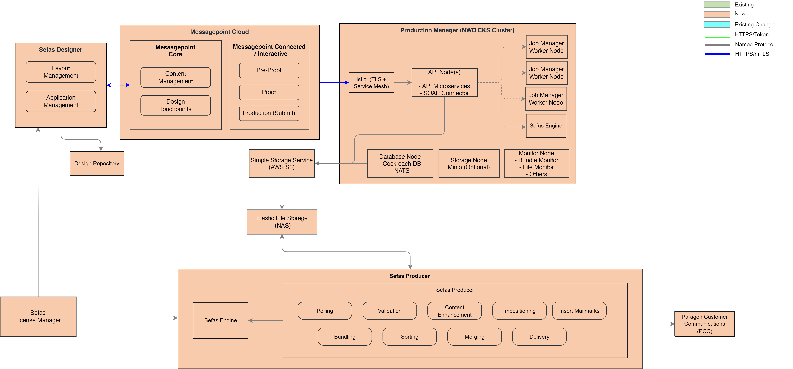
Design: Communication Composition Services – 1/2
Notes:
Messagepoint Connected is a Saas based managed service provided by Messagepoint
Messagepoint Production Manager will be docker containerized and orchestrated through Amazon EKS (Elastic Kubernetes Service)
Sefas producer will be docker containerized and orchestrated through Amazon ECS (Elastic Container Service)
This will help in meeting NFR requirements around system availability, security, load management etc.
License Manager shall be deployed to EC2 instance, not to Pod. This is due to the ID for which the license was generated.
Disaster recovery, or failover policies are at infrastructure level

Slide 29
Design: Communication Composition Services – 2/2
Developers Use Messagepoint SaaS/Web based solution hosted in Messagepoint Data Center (DC) to design touchpoints, manage content & finalize touchpoints through inbuilt sefas connector. The Messagepoint shall be used to store and to reuse centralised assets (images etc..) during touchpoint creation.
Developers use on-prem Sefas HC designer to create Master Templates & Layouts. The approved design is stored into design repository
Design repository centrally manage templates, resources etc..
Business user's logon to newly built Communication Composition Portal (CCP) & create an order for correspondence through Messagepoint Connected interview and interactive steps
Upon making all changes on an order, user sends the proof request, and a PDF document is generated by Messagepoint Production Manager either for local print or central print based on value selected by user from the interview screen. The production manager generates and uploads files (PDF + VPF + VPF Index) into AWS Simple Storage Service (AWS S3)
A scheduled polling script runs after 7PM BST and downloads S3 files to EFS (NAS Storage). Sefas producer polls for generated copies of communication in the EFS storage and handle the post-processing of documents & SFTP to GSS. GSS then delivers SFTPed files to end-customers through Print Service Provider (PSP) viz; Paragon Customer Communications (PCC). Generated communications does not necessarily go through all steps depicted in the diagram, instead only eligible steps are applied, and communications are delivered. GSS also sends PDF file to ECM archival system
The VPF file is converted to AFP, containing all required production markings, along with TLE indexes after necessary post-processing using sefas engine and submitted to print-provider for delivery to the customer. The list of files sent to PSP is maintained in the reconciliation database for reporting, & reprocessing. Generated PDF files are batched with metadata and sent for archival.
PSP may generate file with list of all failed communications and pass back to be used for reconciliation at the reprocessing. Delivery of communication is maintained in communication tracking database for reporting or reprocessing purpose
To transfer transfer files within NatWest GSS to PCC via Connect Direct, SP031 is used
To transfer transfer files from Natwest GSS system to external sources via Connect Direct, SP032 is used

Slide 30
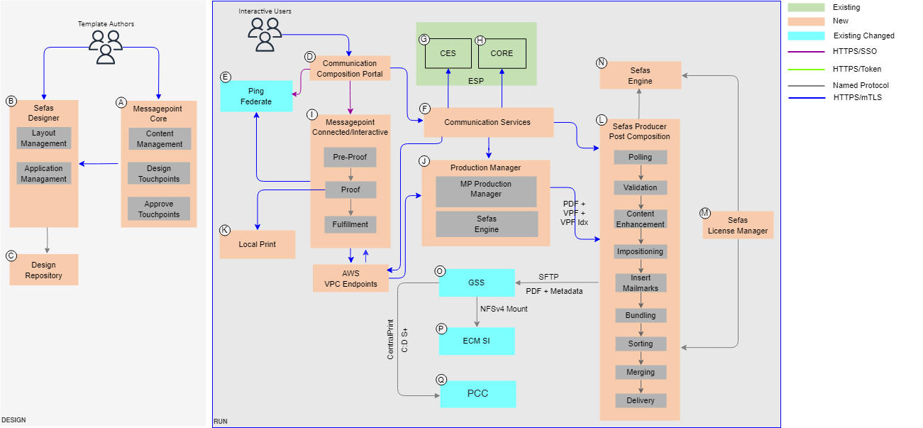
Design: End to End Flow
MP Connected is a SaaS based managed service provided by Messagepoint
Messagepoint Production Manager & Sefas producer will be docker containerized.
Messagepoint Production Manager is orchestrated through Amazon EKS (Elastic Kubernetes Service)
Sefas Producer Manager is orchestrated through Amazon ECS (Elastic Container Service)
This will help in meeting NFR requirements around system availability, security, load management etc.
Sefas License Manager is dockerized and deployed across AZs with a dedicated hostname.
Disaster recovery, or failover policies are at infrastructure level
Using SCP_046 system allows credentials from one authentication mechanism to be used across multiple systems within an organisation or multiple organisations.
Secured consumption of 3rd party SaaS service is through SCP_056. This protects bank information residing at 3rd party, if any
Notes:
Messagepoint Connected is a Saas based managed service provided by Messagepoint
Messagepoint Production Manager will be docker containerized and orchestrated through Amazon EKS (Elastic Kubernetes Service)
Sefas producer will be docker containerized and orchestrated through Amazon ECS (Elastic Container Service)
This will help in meeting NFR requirements around system availability, security, load management etc.
License Manager shall be deployed to EC2 instance, not to Pod. This is due to the ID for which the license was generated.
Disaster recovery, or failover policies are at infrastructure level

Slide 31
Design: End to End Flow -2\3
 | Developers use Messagepoint SaaS/Web based solution hosted in Messagepoint DC to design touchpoints, manage content & finalize touchpoints through inbuilt sefas connector. The touchpoint composition may have an optional approval process, if required. The approved design is stored into design repository
 | Developers use on-prem Sefas HC designer to create Master Templates & Layouts. The approved design is stored into design repository
 | Design repository used to manage templates, resources etc.. centrally
 | Business users logon to newly built Communication Composition Portal (CCP) & a signed SAML request is sent to PingFederate for authentication. A synchronous SAML response is received with all details like name, group etc. The response is processes by Communication Composition Portal (CCP) for authorization to various Communication Composition Portal (CCP) modules
 | A signed SAML request for authentication is received by PingFederate and a synchronous response is pass back to service provider for further processing
 | Various Communication Services (CS) are used written and are utilized for processes like calls to connected, routing, transform, compose, Management Information (MI) reports etc.
 | Core CES SOAP based web-service is consumed through ESP (Enterprise Service Platform) to create new or update existing customer events like local print, cancel print, generate Management Information (MI) report etc..
 | Core CICS Core SOAP based web-service is consumed through ESP (Enterprise Service Platform) to fetch Customer Statement Address, Brand information etc..
 | On SaaS based Messagepoint Connected / Interactive UI user verifies prefilled information, add/modify editable fields on Interactive screen, if required and selects pre-proof. Upon making all changes on interactive screen, user sends the proof request and a PDF document is generated rendered back to the user.
 | Messagepoint Production manager takes in pre-proof request and responds back with JSON response for interactive experience. The proof request is processed by production manager, a PDF generated through Sefas engine and is returned back to connected UI. The production/fulfilment request bundle is used by Sefas engine to generate VPF output along with metadata into the spool directory (NAS storage). For central print VPF file along with metadata is generated.
 | Generated Proof PDF may be printed locally by colleagues. Corresponding customer event request will be logged through core CES service
A
B
C
D
E
F
G
H
I
J
K

Slide 32
Design: End to End Flow – 3\3
 | Sefas producer polls for generated copies of communication and handles the post-processing of documents and batch delivery through 3rd party print service provider viz; Paragon. Generated communications does not necessarily go through all steps depicted in the diagram instead only eligible steps are applied and communications are delivered. Delivery of communication is maintained in communication tracking database for reporting or reprocessing purpose
 | Sefas license manager provisions licensing to Sefas Producer & Sefas engine and monitors the usage
 | Sefas engine is used to generate the actual print copy after the job has gone through all post-production steps in producer workflow
 | Files generated through Sefas Producer are SFTP’ed to GSS for delivery to print service provide (PCC)
 | Generated PDF files are batched with metadata, SFTP’ed to GSS. GSS transfers files to ECM EC1. Archived PDF copies could be retrieved by authorized colleagues from ECM portal
 | The VPF file is converted to AFP with TLE indexes after necessary post-processing and submitted to print-provider Paragon Customer Communications (PCC) for delivery to the customer. The list of files sent to PSP is maintained in the reconciliation database for reporting, & reprocessing.
L
M
N
O
P
Q

Slide 33
Design: Key Functionality and Call Paths
What is the high level functionality for this Solution and the key building blocks to deliver it?
Should be precise in identifying a clear list of functions used in the solution along with a set of systems (along the call path) required to deliver each of these functions. A simple text form formula approach can be adopted to formalise and represent this in a table (example below) or replace with interaction diagrams or other diagrams where appropriate:
Functions | Formula
Colleague Single Sign-On Communication Composition Portal (CCP) | Browser -> Communication Composition Portal (CCP) -> Ping Federate -> Active Directory -> Ping Federate -> Communication Composition Portal (CCP)
Colleague Single Sign-On Communication Composition Portal (CCP) & Messagepoint Connected UI | Browser -> Communication Composition Portal (CCP) -> Ping Federate -> Active Directory -> Ping Federate -> Communication Composition Portal (CCP) -> Browser (MPDC Redirect) -> Messagepoint Connected UI -> Ping Federate -> Active Directory -> Ping Federate -> Browser -> Messagepoint Connected UI
Local Print | Communication Composition Portal (CCP) -> Communication Services (CS) -> CORE -> MP Preview/Proof -> MP Production Manager (Local Print Job Bundle + Sefas Engine) -> AWS S3 -> Communication Services (CS)
Centralized Print | Communication Composition Portal (CCP) -> Communication Services (CS) -> CORE -> MP Preview/Proof -> MP Production Manager (Local Print Job Bundle + Sefas Engine) -> AWS S3 -> Sefas Producer -> GSS -> PCC
Get customer details from Core Services (Customer Statement Address) | Browser -> Communication Composition Portal (CCP) -> Communication Services (CS) -> ContactPreferenceManagement web service -> Communication Services (CS) -> Communication Composition Portal (CCP)
Create Customer Event Services (CES) events | Browser -> Communication Composition Portal (CCP) -> Communication Services (CS) -> CommunicationManagement -> Communication Services (CS) -> Communication Composition Portal (CCP)
Get customer details from Core Services (Customer Statement Address) | Browser -> Communication Composition Portal (CCP) -> Communication Services (CS) -> CustomerArrangementManagement web service -> Communication Services (CS) -> Communication Composition Portal (CCP)

Slide 34
Design: High Level Data Design - 1\4
As per the proposed solution, customers data will be extracted from existing core banking systems through CICS Core Services
There are no requirements to migrate data
Resources that are withdrawn or expired shall be periodically removed from the repository
On expiry of the records retention period, the solution shall delete records from platform.
Reporting & Management Information (MI) functionality will be delivered from within Communication Composition Portal
To store communications into ECM SI instance, the new solution must send the metadata in PPD format
Documents shall be retained for a maximum of 10 years in the ECM SI archival system
Communication Composition Portal (CCP)
The Communication Composition Portal (CCP) will maintain the following details in this database:
Audit data and some MI Data containing details of a letter when it is locally printed, submitted for production printing or cancelled.
Sort Code Brand mapping data.
MI reporting data capture within Audit table
Staff related group information required for authorization with the CCP application.
Centre information containing details of centre to which the staffs belong.
Team information containing details of team to which the staffs belong.
Team assignment
Team Maintenance

Slide 35
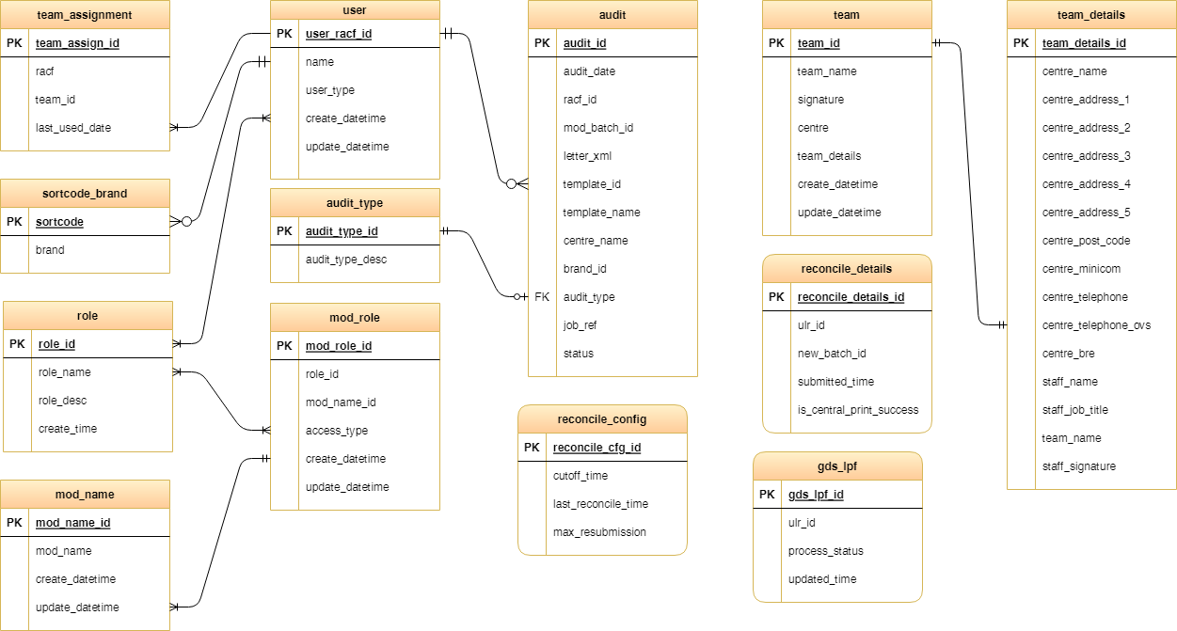
Design: High Level Data Design - 2\4

Slide 36
Design: High Level Data Design - 3\4
Communication Services (CS)
The CCM service databases will maintain following details
Print Spool or document generation information
Core services instance lookup & customer events update
Management Information
Data Transformation
Communication Tracking information
Data Retention:
Order data are retained in Document DB for 7 years, PDF’s generated as part of the order are also retained in S3 for 7 days
MP internal files VPF & VPF Index files generated are retained in S3 for 3 days for any re-processing requirement

Slide 37
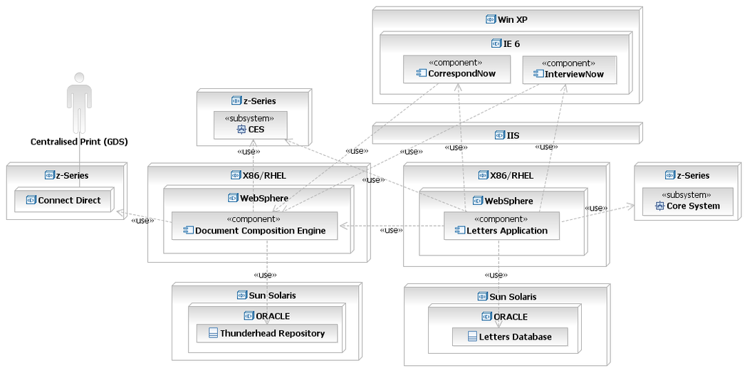
Design: Infrastructure Design – As Is

Slide 38
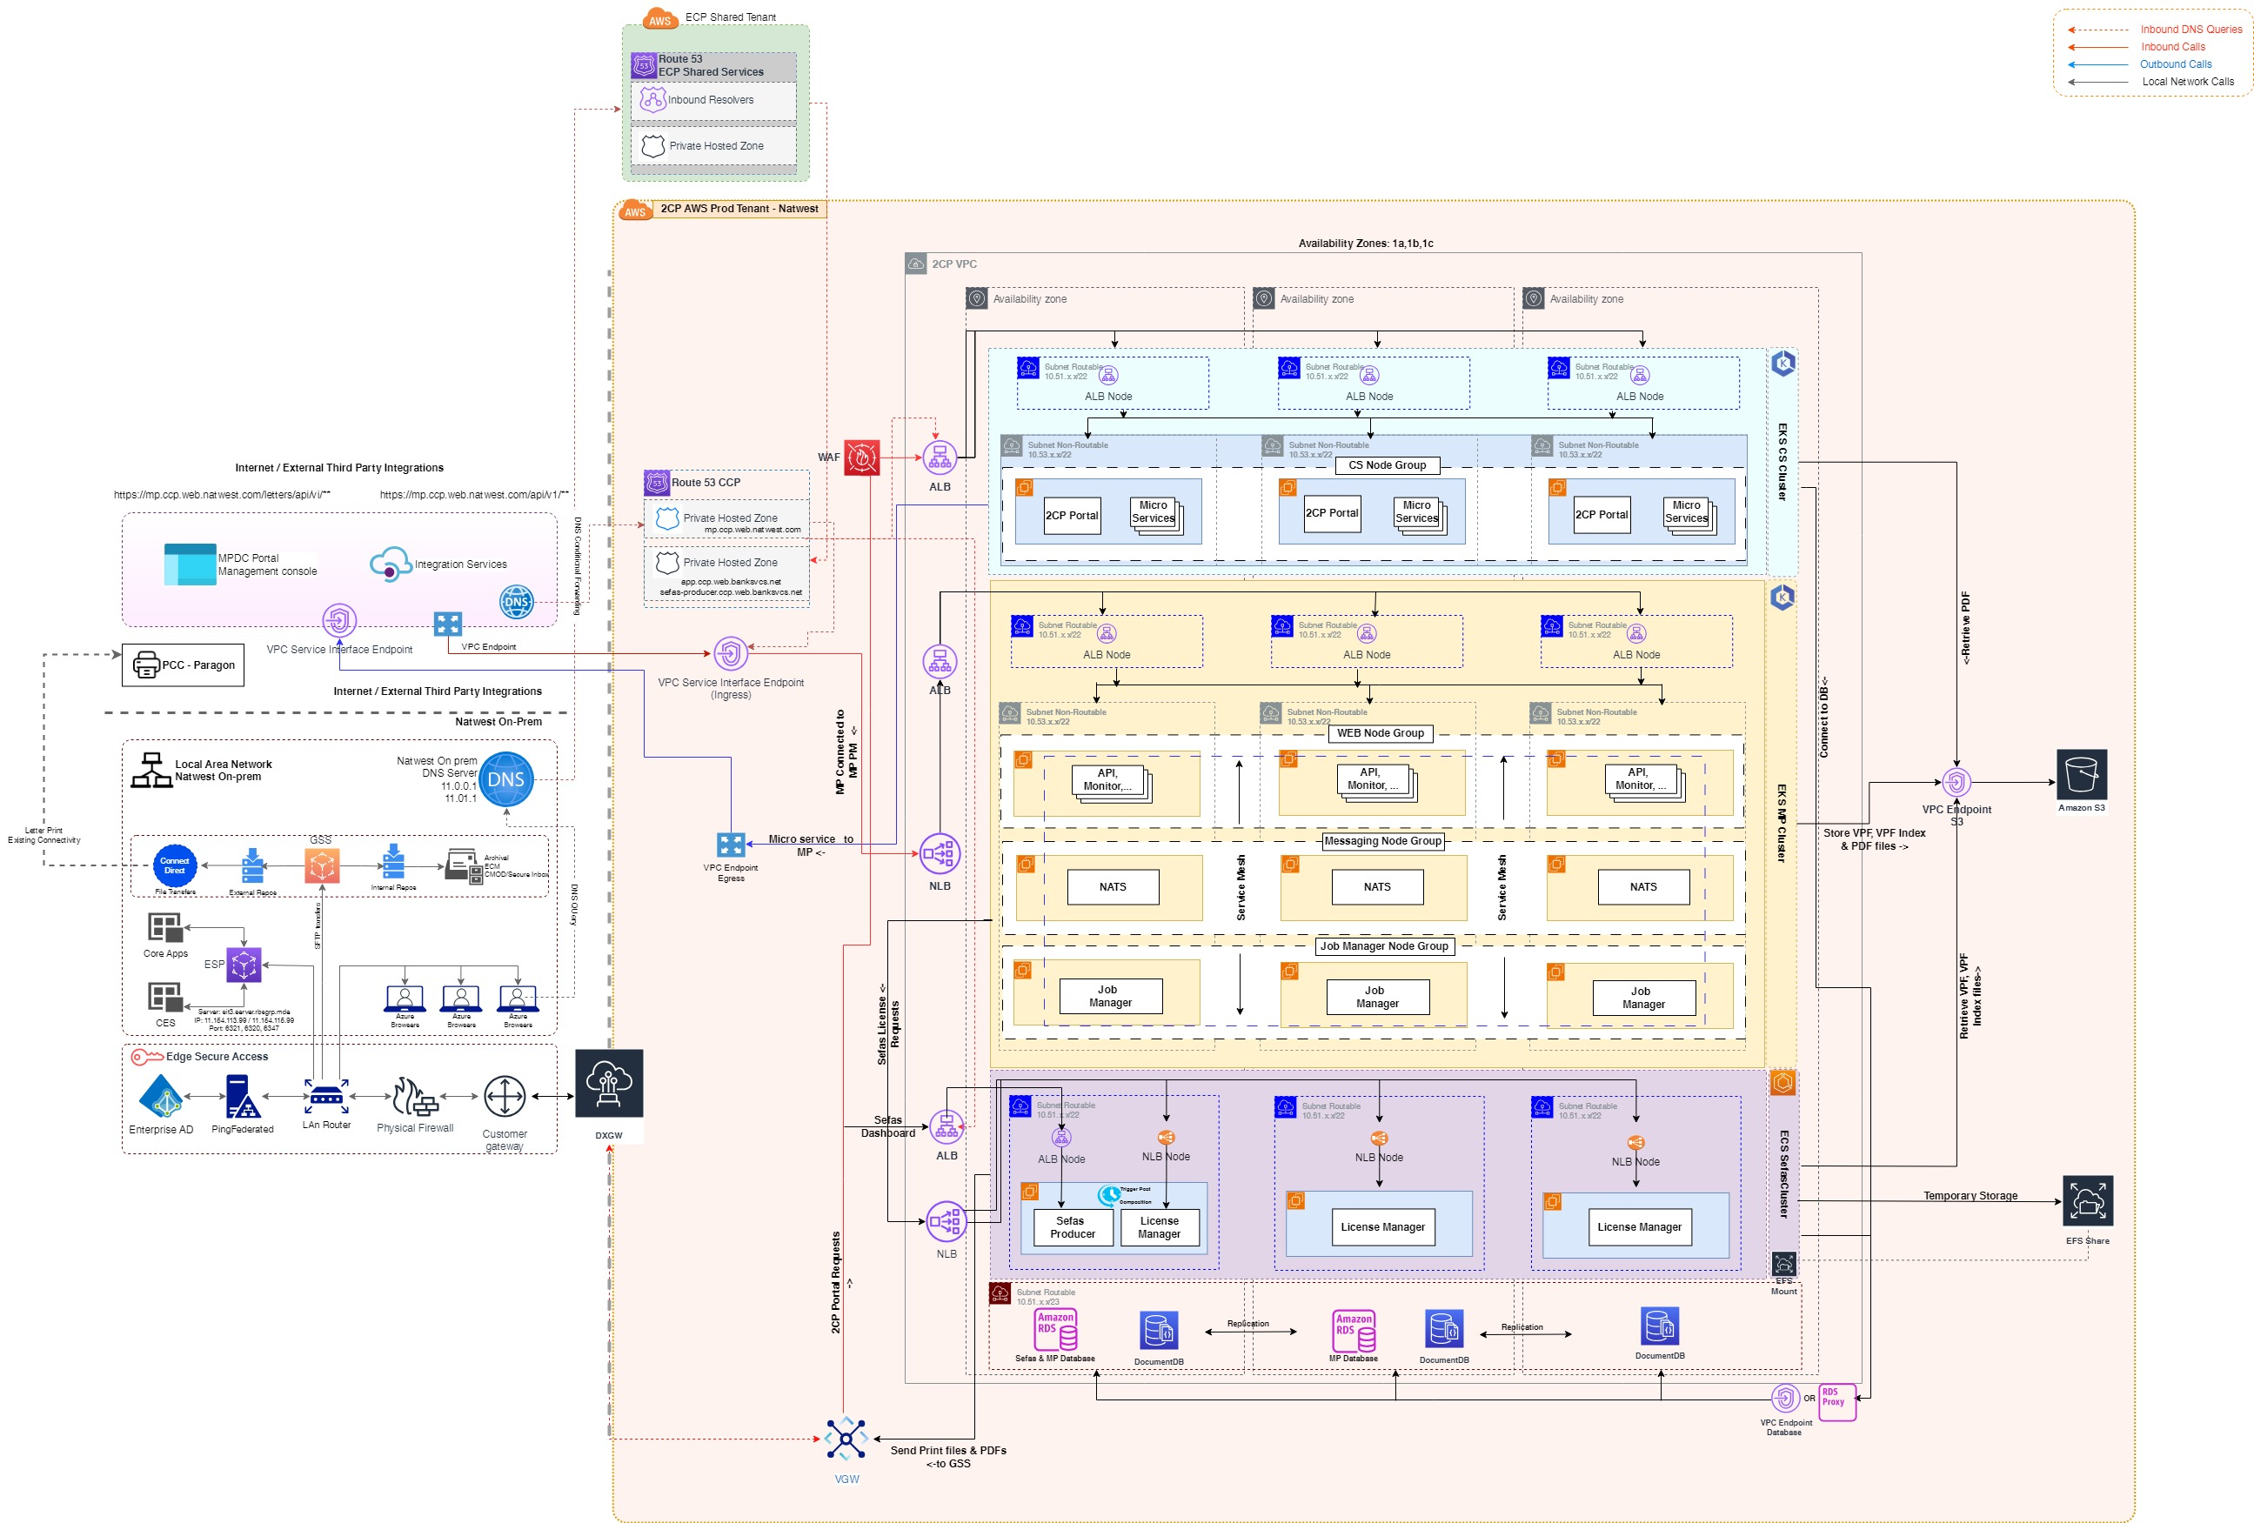
Design: Infrastructure Design – To Be
Notes:
Autoscaling
In EKS, we can take advantage of pod autoscaling. Pod autoscaling can dynamically add or remove microservices pods as needed. For scaling down we need to set expected cluster size during creation.
High Availability
For High Availability, we can use Availability Zones. We need to use at least 3 zones for Stateful Architecture to provide High Availability.
Amazon Elastic Filesystem (EFS) can provide High Availability behind the scene.

Slide 39
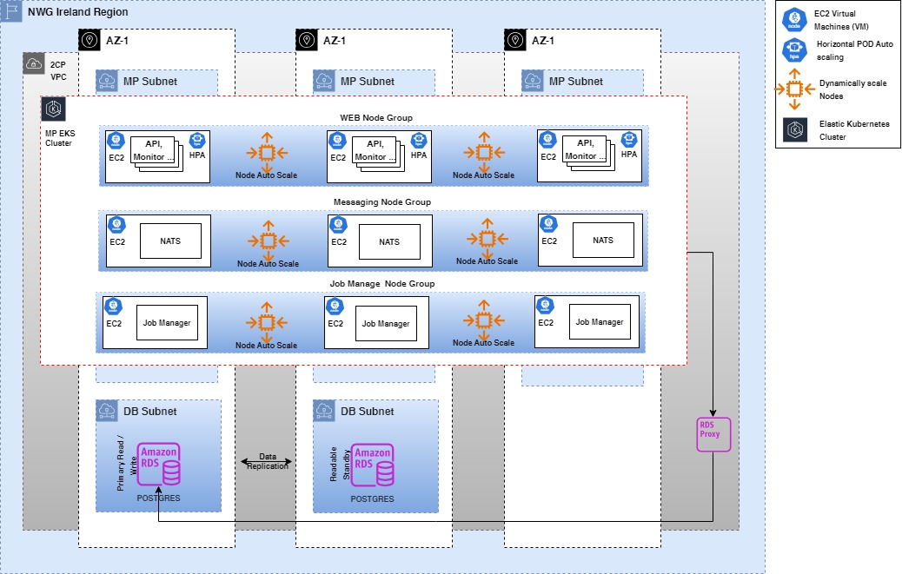
MessagePoint EKS Cluster
Below diagram depicts the MessagePoint EKS Cluster with:
3 Node Groups one each for WEB, Messaging & Job Manager
Each Node Groups consists of 3 Nodes spread across 3 AZs
Note: Tough the standard is to deploy workloads across 3 AZs, the plan is to deploy them only in 2 AZs as 2CP is a non-IBS application & will meet the RTO = 24 Hrs

Slide 40
MessagePoint EKS Cluster (Node Group Details)
Node Group | Configuration | Node Count
Messaging (NATS) | r7i.large(2 CPUs, 16GB RAM) | 3, spread across 3 AZs
WEB(API, Monitor) | c7i.2xlarge(8 CPUs,16 GB RAM) | 3, spread across 3 AZs
Job Manager | c7i.large(2 CPUs, 4GB RAM) | 3, spread across 3 AZs
Database | RDS db.r6i.large | 1 Primary & 1 Secondary
Component | MP or Third Party(TP) | Node Selector | Horizontal POD Autoscaling | Dynamic scaling of nodes | Comments
Job Manager | MP | Job-manager-x | Not supported for POD configuration of type “Deamon set” | Intend to enable as part of future releases | Deployed as a “Daemon set” by design, the number of replicas are dictated by the number of nodes in the node group
Messaging (NATS) | TP | messaging |  | Will be enabled based on load testing results
Web | MP | Web | Enabled with default configuration provided with Helm charts | Will be enabled based on load testing results

Slide 41
Service/Infrastructure Summary - 1\6
Where appropriate provide the Product/Pattern reference code. Describe requirements and changes for each service, deployment pattern and infrastructure product. Numbers of servers and/or locations/environments should be included where appropriate. For each also make it clear whether there is any adoption engineering requirement and whether this is under Product or ETF. State the team that supports the component.
Reference links for application monitoring and associated decision trees:
APM - Application Performance Management
Decision trees - https://confluence.dts.fm.rbsgrp.net/display/ESM/Decision+Trees
Service, Pattern or Product Reference | Summary of requirement / change | Standard usage or adoption requirement | Agreed support team | Associated Security Standard
PROD – Messagepoint WEB Components | EKS managed Node groups with AMI family c7i.2xlarge(8 CPUs,16 GB RAM) | Standard Usage | App Support Team
PROD – Messagepoint NATS/Messaging | EKS managed Node groups with AMI family r7i.large(2 CPUs, 16GB RAM) | Standard Usage | App Support Team
PROD – Messagepoint Job Manager | EKS managed Node groups with AMI family c7i.large(2 CPUs, 4GB RAM) | Standard Usage | App Support Team
PROD – Sefas Producer | ECS Nodes with AMI family t3.xlarge (4 VCPUs, 16 GiB Memory) | Standard Usage | App Support Team
PROD - Communication Composition Portal (CCP) | EKS managed Node groups with AMI family c6a.4xlarge (16 VCPUs, 32 GiB Memory) | Standard Usage | App Support Team
PROD – Communication services (CS) | EKS managed Node groups with AMI family c6a.4xlarge (16 VCPUs, 32 GiB Memory) | Standard Usage | App Support Team
WIAM-07 | IAM - as per adoption processes documented WIAM-07 - "Federation to SAAS Apps" | Standard Usage | App Support Team | SCP_017 - UCS

Slide 42
Service/Infrastructure Summary - 2\6
Service, Pattern or Product Reference | Summary of requirement / change | Standard usage or adoption requirement | Agreed support team | Associated Security Standard
DR – Messagepoint Production Manager Database | EKS managed docker containers, 3 r5d.xlarge (4 VPCU, 32 GiB RAM), 1 TB SSD | Standard Usage | App Support Team
DR – Messagepoint Production Manager Vault | EKS managed docker containers, 5 c5d.xlarge (2 VPCU, 4 GiB RAM), 1 TB SSD | Standard Usage | App Support Team
DR – Messagepoint Production Manager Web | EKS managed docker containers, 3 c5.2xlarge (8 VPCU, 16 GiB RAM) 1 TB SSD | Standard Usage | App Support Team
DR – Messagepoint Production Manager Monitoring | EKS managed docker containers, 1 c5.xlarge (2 VPCU, 4 GiB RAM), 1 TB SSD | Standard Usage | App Support Team
DR – Messagepoint Production Manager | EKS managed docker containers, 2 Job Manager Servers, 4 vCPU, 16GB RAM, 1 TB SSD | Standard Usage | App Support Team
DR – Sefas Runtime Engine (Platform) | ECS managed docker containers, RHEL8 (64bits) 4 vCPU 4Gb HDD (install size) 4Gb RAM | Standard Usage | App Support Team
DR – Sefas Producer | ECS managed docker containers, RHEL8 (64bits) 4 vCPU 4Gb HDD (install size) 4Gb RAM | Standard Usage | App Support Team
DR – Sefas License server | EC2 RHEL8 (64bits), 1 CPU 1GB RAM (even less) 100Mb disk | Standard Usage | App Support Team
DR - Communication Composition Portal (CCP) | EKS managed docker containers (1 POD), RHEL 8 (64-bits), 4 vCPU, 16GB RAM, 20GB SSD | Standard Usage | App Support Team
DR – Communication services (CS) | EKS managed docker containers (10 services with 2 PODS each – initial size), RHEL 8 (64-bits), 4 vCPU, 16GB RAM, 20GB SSD | Standard Usage | App Support Team

Slide 43
Service/Infrastructure Summary - 3\6
Service, Pattern or Product Reference | Summary of requirement / change | Standard usage or adoption requirement | Agreed support team | Associated Security Standard
UAT – Messagepoint Production Manager Database | EKS managed docker containers, 3 r5d.xlarge (4 VPCU, 32 GiB RAM), 1 TB SSD | Standard Usage | App Support Team
UAT – Messagepoint Production Manager Vault | EKS managed docker containers, 5 c5d.xlarge (2 VPCU, 4 GiB RAM), 1 TB SSD | Standard Usage | App Support Team
UAT – Messagepoint Production Manager Web | EKS managed docker containers, 3 c5.2xlarge (8 VPCU, 16 GiB RAM) 1 TB SSD | Standard Usage | App Support Team
UAT – Messagepoint Production Manager Monitoring | EKS managed docker containers, 1 c5.xlarge (2 VPCU, 4 GiB RAM), 1 TB SSD | Standard Usage | App Support Team
UAT – Messagepoint Production Manager | EKS managed docker containers, 2 Job Manager Servers, 4 vCPU, 16GB RAM, 1 TB SSD | Standard Usage | App Support Team
UAT – Sefas Runtime Engine (Platform) | ECS managed docker containers, RHEL8 (64bits) 4 vCPU 4Gb HDD (install size) 4Gb RAM | Standard Usage | App Support Team
UAT – Sefas Producer | ECS managed docker containers, RHEL8 (64bits) 4 vCPU 4Gb HDD (install size) 4Gb RAM | Standard Usage | App Support Team
UAT – Sefas License server | EC2 RHEL8 (64bits), 1 CPU 1GB RAM (even less) 100Mb disk | Standard Usage | App Support Team
UAT - Communication Composition Portal (CCP) | EKS managed docker containers (1 POD), RHEL 8 (64-bits), 4 vCPU, 16GB RAM, 20GB SSD | Standard Usage | App Support Team
UAT – Communication services (CS) | EKS managed docker containers (10 services with 2 PODS each – initial size), RHEL 8 (64-bits), 4 vCPU, 16GB RAM, 20GB SSD | Standard Usage | App Support Team

Slide 44
Service/Infrastructure Summary - 4\6
Where appropriate provide the Product/Pattern reference code. Describe requirements and changes for each service, deployment pattern and infrastructure product. Numbers of servers and/or locations/environments should be included where appropriate. For each also make it clear whether there is any adoption engineering requirement and whether this is under Prodcat or ETF. State the team that supports the component.
Reference links for application monitoring and associated decision trees:
APM - Application Performance Management
Decision trees - https://confluence.dts.fm.rbsgrp.net/display/ESM/Decision+Trees
Describe Application Operational Management Design
Service Category | Application component(s) | Monitoring, alerting, logging & heart-beating design and products
General | AWS Region | Each AWS Region is a separate geographic area
General | AWS Availability Zones | Availability Zones are distinct locations that are engineered to be isolated from failures in other Availability Zones.
Compute | EC2 (Elastic Cloud Compute) | It is a virtual server that provides resizable compute capacity on the cloud.
Compute | Amazon ECS (Elastic Container Service) | Amazon Elastic Container Service (Amazon ECS) is a highly scalable and fast container management service.
Compute | Amazon EKS (Elastic Kubernetes Service) | Amazon Elastic Kubernetes Service (Amazon EKS) is a managed service that is used to run Kubernetes on AWS without needing to install, operate, and maintain own Kubernetes control plane or nodes.
Management & Governance | AWS CloudWatch | Monitoring services for AWS resources & applications. If this service down then critical resource and application metrics will not be available
Container Image Registry | Amazon ECR (Elastic Container Registry) | AWS managed container image registry service that is secure, scalable, and reliable

Slide 45
Service/Infrastructure Summary - 5\6
Service Category | Application component(s) | Monitoring, alerting, logging & heart-beating design and products
Network | VPC | Amazon Virtual Private Cloud (VPC) is a virtual data centre in AWS consisting of a set of isolated resources.
Networking | Application Load balancer | Automatically distributes incoming application traffic across multiple targets and virtual appliances in one or more Availability Zones (AZs).
Networking | Public Subnet | A public subnet is a subnet that's associated with a route table that has a route to an internet gateway
Networking | Private Subnet | A public subnet is a subnet that's associated with a route table that doesn’t have a route to an internet gateway
Networking | CNF (Cloud Network Connectivity) | This service provide shared network connectivity solution when connecting with different Cloud service providers (CSPs)
Networking | API Gateway | AWS API Gateway is used to create, maintain, monitor, and secure APIs.
 | VPC Endpoints | Enables privately connect your VPC to supported AWS services and VPC Endpoint services via Private Link
Security, Identity & Compliance | AWS WAF (Web Application Firewall) | It protects our web application from attacks by providing web traffic filters. Rate limiting feature for order creation traffic originating from VCS has also been built.
Security, Identity & Compliance | IAM (Identity Access Management) | A web service that helps you securely control access to AWS resources.
Security, Identity & Compliance | AWS Certificate Manager | AWS Certificate Manager is designed to protect and manage the private keys used with SSL/TLS certificates
Security, Identity & Compliance | AWS Shield | AWS Shield provides protection against a wide range of known DDoS attack vectors and zero-day attack vectors

Slide 46
Service/Infrastructure Summary - 6\6
Service Category | Application component(s) | Monitoring, alerting, logging & heart-beating design and products
Storage | Amazon RDS (Relational Database Service) | Cloud Watch Logs, Metrics & Alarms
Storage | Amazon S3 (Simple Storage Service) | It refers to Simple Storage Service and allows the storage of data objects of any sort and flat files in the cloud. It is secure, scalable, and durable.
Storage | Amazon EFS (Elastic File Storage) | It is a file storage service that is mounted to multiple EC2 instances. Files generated into EFS are eventually transferred to various downstream system
Storage | Amazon DocumentDB | Amazon DocumentDB (with MongoDB compatibility) is a fast, reliable, and fully managed database service

Slide 47
Security Design – Summary of Security Control Patterns
Security Control Pattern | Rationale
WIAM-07 | Need to enable NWG workers (staff) to access external SaaS from Intranet
IP400 | Need to enable NWG workers (staff) to leverage their existing credentials to seamlessly login to NWG/TPP workers application (secondary application)
SCP_056 | Need to ensure secure connectivity to the SaaS application via bank standard connectivity models. Adherence to the Bank information management policy and data classification, ensuring only approved data is stored, securely managed and protected within the SaaS app
SCP_046 | Federated Single Sign On allows credentials from one authentication mechanism (for example Active Directory) to be used across multiple systems within a single organisation or multiple organisations
SP031 | Need to transfer transfer files from NatWest GSS internal application to another on a scheduled basis
SP032 | Need to transfer transfer files from NatWest applications to external sources via GSS through Connect Direct
VPC Endpoint | To establish a secure connection between MP Production Manager & MP SaaS application as the data set used contains customer confidential data (Customer Name & Address)

Slide 48
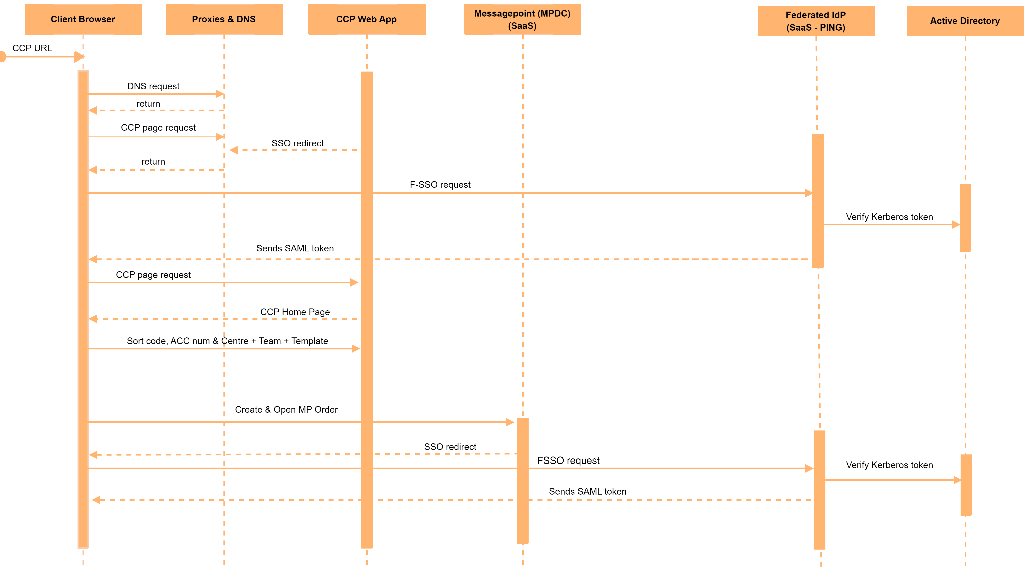
Security Design: Application Authentication 1/2

Slide 49
Security Design: Application Authentication 2/2
Pre-requisites
2CP must be onboarded to IAM (Ping Federate)
MPDC must be onboarded
User triggers Communication Composition Portal (CCP) URL from browser
Request will go-through with proxies and DNS and invokes the 2CP page request.
Communication Composition Portal (CCP) Web App redirects the request to PingFederate authentication provider (PingIdP).
Ping Federate reads EUROPA domain user information using Kerberos token & generates a SAML response token.
Ping Federate sends SAML token back to browser.
Now page requested with token and Communication Composition Portal (CCP) Web App home screen appears.
User enters Centre Name, Team Name, Sortcode, Account Number, MP Template (Touchpoint) & clicks on submit
MP Connected order is created by 2CP using CreateConnectedOrder MPDC Web-Service.
Communication Services builds the redirection URL (https://login.messagepoint.com/mp/connected_portal_gateway.form?touchpoint_guid=<tpguid>&order_guid=<2CP –generated-order_guid>&company=<company_name>&instance=production&pre-release=false&return_url=<entity_encoded_url>&return_to_list=false) and opens the created order in a new browser tab
MPDC (Messagepoint SaaS) generates SAML request and redirects the user to PingFederate for authentication.
Ping Federate generated SAML Response and authenticates the user and user is shown the created order interview screen

Slide 50
Resilience Design including deviations from standards and patterns – 1\3
IT Resilience policy compliance is a mandatory requirement for all new and changing Service Elements Contact: ~ Resilience & Continuity, Resource & Demand for support.
The key resilience and continuity design approach is summarized as below.
The capability to maintain IT Application availability and or recover from the loss of a Data Centre, Cloud Hosting Location (region), Infrastructure, Network, Data or Corruption, or an IT Application.​
Infrastructure Resilience – AWS – Workloads are configured to use, a stretched cluster which consist of 3 Availability Zone (AZ's) where data is synchronously replicated to hosts in different AZ’s.
Each Availability Zone is engineered to be isolated from failures in other Availability Zones. By launching in separate Availability Zones, applications are protected from the failure of a single location.
To enable infrastructure to be redeployed quickly without errors, Infrastructure as a code (IaC) preferably Terraform shall be employed. This helps in meeting the Recovery Time Objective (RTO).
Application Load balancer automatically distributes incoming application traffic across multiple targets and virtual appliances in one or more Availability Zones (AZs)
API Gateway is used to create, maintain, monitor, and secure APIs.
AWS resources are secured using private network. AWS resource are placed either in public or private subnet within AZ’s based on accessibility requirements. Traffic to network & resource is protected through AWS shield & API Gateway
Resilient and fault tolerant IT Applications, including the capability to operate from a single site without single points of failure.​
All services & applications are designed to be fault tolerant, and scalable using a pre-configured set of a replica counts. It relies on Kubernetes to ensure that the replica count is maintained. If a pod crashes, the Kubernetes master brings up another instance of the pod in order to maintain the replica count. The services & applications are deployed over 3 availability zones.
To help manage workloads across multiple AZ’s load balancers have been implemented

Slide 51
Resilience Design including deviations from standards and patterns – 2\3
IT Resilience policy compliance is a mandatory requirement for all new and changing Service Elements Contact: ~ Resilience & Continuity, Resource & Demand for support.
The key resilience and continuity design approach is summarized as below.
Meeting the resilience and recovery requirements of Inter-IT Application dependencies.​
- N/A
Capability to recover from both replicated AND backup data stores reflecting the business requirements, including recovery point objectives.​
Data is synchronously replicated across multiple AZ’s instances. Through synchronous replication, data on standby instance is kept up to date with primary. When a failure is detected, the DB instance automatically fails over to standby instance without manual intervention and serve the workload from primary. This helps in meeting the Recovery Point Objective (RPO)
Monitoring and alerting capability to detect adverse events before they impact customers.
Monitoring collects operational logs, metrics, events & traces to identify & respond to issues quickly and avoid disruptions
AWS CloudWatch will be in place to enable the monitoring & alerting capabilities for AWS resources. CloudWatch data may be brought alongside AWS managed service for Prometheus & Grafana to improve the ability to join or query across for a holistic view of the system.
If S3 service is down, then documents will not be stored to S3 hence document post processing cannot happen. Also, CloudWatch metrics for S3 will not be available till the time service is up and running
If EFS services is down, then generated documents cannot be stored. This will affect critical operations like post-production, document archival. Also, CloudWatch metrics for ECS and other dependant components will not be available till the time service is up and running
If EKS service is down then critical components of the solution like Customer Composition Portal (CCP), Communication Services (CS), MP Production Manager will be affected, and users won't be able to use the system. Also, CloudWatch metrics for ECS and other dependant components will not be available till the time service is up and running

Slide 52
Resilience Design including deviations from standards and patterns – 3\3
IT Resilience policy compliance is a mandatory requirement for all new and changing Service Elements Contact: ~ Resilience & Continuity, Resource & Demand for support.
The key resilience and continuity design approach is summarized as below.
If ECS service is down, then Sefas components will be unavailable. The documents generation, post-composition & document delivery will be affected. Also, Container Insights, CloudWatch metrics for ECS and other dependant components will not be available till the time service is up and running
Capacity and performance management to ensure they meet the immediate and on-going needs of the business service.
- Capacity of the database & servers are done based on the number of concurrent users, number of hits, volume , peak volume to the application. As part of solutioning, an analysis with businesses users, product and application teams have been conducted to make sure that business needs are met.
Resilience and continuity proving capability to allow for implementation and subsequent periodic testing.
- 2CP is tier 3 application and the resilience would be tested by the project, to ensure all resilience aspects are incorporated within the design work as expected.

Slide 53
Connections: Protocols, Security & Resilience – 1\2
Where connections pass through load balancers or firewalls without terminating then these are not to be regarded as components and should be added as a note in the Receiving Component. The protocol for the connection, such as MQ, HTTPS and whether privacy is provided by TLS, for example, should be provided. The receiving node should normally authenticate and authorise the requesting node’s identity; the mechanism for this should be stated. Connection Resilience should describe load balancing and fault tolerance responsibilities, method of identifying target endpoints, endpoint health and retries etc.
Component establishing connection | Component receiving connection | Connection Protocol and Privacy | Connection Authentication and Authorisation | Connection Resilience
Sefas Producer | GSS | SFTP | NA
GSS | PCC | C:D/S+ | SHA-2 Certificate (Existing) | As outlined in SP032
Communication Composition Portal | Communication Services | HTTPS | NA
Communication Services | Communication Composition Portal | HTTPS | NA
Communication Services | MP Production Manager | HTTPS | NA
Communication Services | CORE | HTTPS | NA
Communication Services | CES | HTTPS | NA
Communication Services | Ping Federate | HTTPS / TLS 1.2 | SAML 2.0 | As outlined in WIAM-07
Messagepoint Interactive (MPDC) | Ping Federate | HTTPS / TLS 1.2 | SAML 2.0 | As outlined in WIAM-07

Slide 54
Connections: Protocols, Security & Resilience – 2\2
Component establishing connection | Component receiving connection | Connection Protocol and Privacy | Connection Authentication and Authorisation | Connection Resilience
AWS ALB | Sefas | HTTPS | TLS1.2
Istio Ingress with AWS ALB | Messagepoint Production Manager | HTTPS | TLS1.2
AWS ALB Ingress controller | Communication Services | HTTPS | FSSO
MP Production Manager | MP SaaS application | HTTPS | TLS1.2 | Connection is established via AWS VPC Endpoint

Slide 55
Solution Resilience Design (1/2)
For each solution component refer to the specific standard pattern or describe the operational resilience (infrastructure component fault-tolerance) and Data centre failure resilience design. If there is a Response resilience requirement then this should also be described.
Solution component | Operational Resilience | Data Centre Resilience | Response Resilience (if required)
EKS (Communication Composition Portal , Communication Services) | Application will be deployed on a Node Group spread across AZs to handle resiliency at AZ level | Application is currently deployed only in one AWS Region with resiliency provided at AZ level
Messagepoint Production Manager | Application will be deployed on a EKS Node Group spread across AZs to handle resiliency at AZ level | Application is currently deployed only in one AWS Region with resiliency provided at AZ level
Sefas Producer | Application will be deployed and managed through ECS cluster with nodes across AZs. Any interruption to the AZ will impact this component & has been raised as a risk | Application is currently deployed only in one AWS Region with resiliency provided within AZ
RDS (Postgres) - Sefas | One instance of DB is deployed in a single AZ. Any interruption to the DB instance or to the AZ will have a service impact | No data centre resiliency configured for this component
RDS (Postgres) - MP | Two instance (Primary & Secondary) of DB is deployed spread across 2 AZs. | DB is currently deployed only in one AWS Region with resiliency provided at AZ level
DocumentDB | DB instances (one primary and two replicas) are deployed to Multi-AZ DB Cluster in three different availability zones | Application is currently deployed only in one AWS Region with resiliency provided at AZ level

Slide 56
Solution Resilience Design (2/2)
Data
Describe for each data store in the design how that data is stored and replicated for resilience and how the data is backed up and capable of being restored to meet the required RTO and RPO. It is acceptable (and preferred) to refer to specific standard platform backup and recovery standards. Any specific non-standard requirements should be explained.
Data Store | Data Storage/Replication | Backup/restore
RDS (Postgres) | Through replicas | S3
DocumentDB | Through replicas | S3
S3 | Through replicas | S3
EFS | Through replicas | S3

Slide 57
Capacity, Volumes & Performance
Where capacity requirements or volumes are significant, for example in registered users, transaction rates or database/file volumes for certain components of the system then this slide should be included and details completed in the table below.
Application Component / Infrastructure Component | Measurable Business or Technical Volumetric (trans/sec, GB etc) | Current volumes | Day 1 requirement |  | 12 month requirement |  | 3 year requirement**
 |  |  | Average | Peak | Average | Peak | Average | Peak
MP Production Manager | Code & Working Storage (TB) | n/a | 1 | 2 | 1 | 2 | 1.3 | 2.6
 | Average size of VPF statement (Kb)* | n/a | 235 | 235 | 235 | 235 | 306 | 306
 | Average size of PDF statement (Kb)* | n/a | 201 | 201 | 201 | 201 | 261 | 261
Sefas Producer | Working Storage Area (TB) | n/a | 2 | 3 | 2 | 3 | 2.6 | 3.9
 | Average size of AFP statement (Kb)* | n/a | 235 | 235 | 235 | 235 | 306 | 306
 | Average size of PDF statement (Kb)* | n/a | 201 | 201 | 201 | 201 | 261 | 261
AFP data information is obtained from Operations team from production environment for 10 days
PDF data is obtained from Letters admin team from production environment for 10 days.
Refer appendix (Capacity, Volumes & Performance) for output generation trend.
* Extrapolated size of PDF/AFP based on assumption (AFP - 10 days of data, PDF – based on sample outputs from user folders)
** Extrapolated 3 years stats by an assumption of 30% increase in volume

Slide 58
Design: Design Assurance
Workload Placement Assessment https://intranet.rbsres01.net/Businesses/Services/Technology/Pages/Cloud-Workload-Placement.aspx
The Workload Placement Decision Tree (WPDT) must be used to determine the most appropriate hosting location for the service. If the result of that WDPT analysis is that the service will be hosted internally (e.g. on-premise Private Cloud or other internal environment such as Virtual / Physical Servers or our Mainframe) then there is no requirement to complete an associated Workload Placement Assessment form, please simply detail the results of the WDPT analysis in the table below. If there is any external Cloud element to the service, then a Workload Placement Assessment form must be completed and appropriate details captured in the table below.
Key Question : Has a Workload Placement Assessment been approved (if required)? Yes / No / Not Applicable*
Technology Governance Framework
The Domain-aligned Architect or Engineer MUST follow the CTORB Scorecard in the Appendix at least once for this design at design completion (a final scoring is part of the audit trail) , but scoring can be performed iteratively during design or whenever design issues arise. Please record use of the Scorecard in the table below , ensuring that at least one scoring is performed at design completion. Additional rows (with dates) can be inserted. Any single No answer from the Scorecard means the overall response to the framework compliance Key Question must be No. A “No” response to the Key Question means that a Referral to Governance must be made. See ‘Making a Referral'.
Key Question : Does this design comply with the Technology Governance Framework? Yes / No* (Refer Appendix: CTORB Scorecard)
Making a Referral
A No answer to either of the above Key Questions means the Design MUST be reviewed and approved at the CTO Review Board (CTORB) . Please follow the process for an identified non-compliance Infrastructure Design Governance Referral - Hosting Solutions - Confluence (rbsgrp.net) . Referrals and their outcomes MUST be recorded in the Design Review section of the HLSD Governance History as part of the audit trail.
Design Assurance Conclusion
* If after iterative design any of the Key Question answers remains as No, the design is not within CTO Governance.
WPDT Analysis Outcome | WPDT reference number | Approved at CTO RB | Approved at WPA
All capabilities required from the solution are available without significant in-house build. Vendor solutions are available that provide all the required features in a single solution. | WPDT-2022-037 | Yes | Yes - WPA Stage 1 Approved with Conditions - 10/02/2022
Date of CTORB Scoring | Aligned with Workload Placement Strategy ? | Uses a known/good Infrastructure configuration ? | Uses existing/supported Infrastructure products ?
08/02/2022 | Yes | Yes | Yes

Slide 59
Design Inputs: Design Decisions Made (1/4)
Decision Name | Options | Recommended Option | Rationale
Hosting solution for the new Interactive Communication Composition Portal (CCP) | AWS ECP GCP | AWS | Mature containerised environment Co-location with Messagepoint (Lightweight component also in AWS) To Reduce the concentration risk of hosting in ECP
Deployment Model for Interactive Communication Composition Portal (CCP) | Virtual Machine Container | Container | To have scalable and available environment Products like SEFAS & Messagepoint also supports the containerization Model Handle OnDemand/Batch transactions
Post Composition & Mailmark solution for Interactive Communication Composition Portal (CCP) | Re-use existing DMH Letters instance Build a new Instance | Build a new Instance for Post composition & Mailmark | New instance will be handling both OnDemand & Batch composition New instance will be built on containerisation which achieves scalability for future business use case
On-Demand letter generation solution | SEFAS e-Access MessagePoint | Messagepoint | Messagepoint is more mature in delivering the on-demand letter requirement As OnDemand Bereavement/CEP use case is for existing interactive letters Consistent operating model Content management and reusable asset in one place
Notes:
Q – Identify the provisioning

Slide 60
Design Inputs: Design Decisions Made (2/4)
Decision Name | Options | Recommended Option | Rationale
Composition Software for Interactive Letter Generation | SEFAS + Messagepoint SEFAS Thunderhead | SEFAS + Messagepoint | Sefas would be used for layout, compose and post composition. Messagepoint to manage content Feature maturity capability more in MP
Core Services usage | New services to be built Reuse the existing service | Reuse the existing service | Requirements for core data have not changed
Archival Solution | ECM SDR ECM EC1 ECM SI Build new instance | ECM SI | ECM SI instance is the strategic solution to archive the outbound correspondence ECM SI instance has both Secure Inbox user journey & Real-time API services ECM SI is strategic digital user journey for the customers. This will also make it easier to serve the documents to customers via SI in future ECM SDR is currently on SAN storage and there are plans to move it to EC1, but it hasn’t started yet. Decision upon building new instance is not finalized
Messagepoint Production Manager Containerised setup | AWS EKS AWS ECS Docker Compose | AWS EKS | AWS EKS is a managed service that natively integrates with Kubernetes to deploy applications. It automatically manages & scales clusters if infrastructure resources on AWS with Kubernetes ECS is not cloud agnostic, doesn’t have built-in load balancing, debugging & logging is complex etc. Docker compose could run containers only in single host machine hence not preferred

Slide 61
Design Inputs: Design Decisions Made (3/4)
Decision Name | Options | Recommended Option | Rationale
Sefas Containerised Setup | AWS EKS AWS ECS Docker Compose | AWS ECS | Sefas supports only docker compose AWS ECS is a managed services and can be easily migrated to EKS when the products are ready with EKS Docker compose could run containers only in single host machine hence not preferred Sefas doesn’t support EKS and AWS Fargate
Management Information (MI) | MI Within Interactive Communication Composition Portal Federated Datamart (Snowflake) | MI within Interactive Communication Composition Portal (CCP) | Majority of reports are specific to the development application Only monthly/annual template volume generation report needed, hence using tactical solution However, the design shall be able to accommodate future requirements in phase-02 around external systems feed & use-cases.
NoSQL for Communication portal and services | Postgres DocumentDB (NoSQL) | DocumentDB | DocumentDB built on distributed and scale out architecture to support performance/volume for communication services Easy ability to rapid changes and multi structure data Auto check for detect failure and auto failover to replicas with minimum downtime and availability impact on applications

Slide 62
Design Inputs: Design Decisions Made (4/4)
Decision Name | Options | Recommended Option | Rationale
Egress Communication between NW AWS & MP AWS Note: Data set used between NW AWS & MP AWS contains Customer confidential data (Customer Name & Address) | SS Egress Proxy VPC Endpoint OnPrem Bluecoat proxy | SS Egress Proxy Chosen: VPC Endpoint | SS Egress proxy in current state is not DLP compliant, hence can’t be used Additional time & effort to build new components OnPrem to route traffic via Bluecoat, a tactical approach, increased complexity, non-standard VPC endpoint uses a private link to establish connectivity between 2 AWS sites. Approved product, proven & time tested and mitigates the DLP risk to an extent
Ingress Communication between MPDC & MP Production Manager | APIGEE VPC Endpoints | VPC Endpoint | During order creation process bundle files are exchanged between MPDC & MP Production Manager, APIGEE is not a right fit for file exchange scenarios Templates with embedded images scenario could exceed bundle file size of 10 MB APIGEE has an inherent limitation on payload / file size of 10 MB Traffic between consumer & APIGEE traverses over internet increasing the risk profile
Workload Resiliency | Deploy across 3 AZs Deploy across 2 AZs | Standard is to deploy across 3 AZs Chosen: Deploy in 2 AZs | Resiliency is predominantly driven by RTO, System criticality & Business needs. 2CP currently is not a critical (IBS) platform & to meet the RTO of 24 Hrs deployment in 2 AZs will suffice

Slide 63
Design Inputs: Roadmaps and Strategic Direction
Future roadmap of platform
Onboarding other lines of business on this and reusing the platform at scale
CCM Capabilities to support one bank strategy
Control, Manage and Offer all outbound communication
Sefas provisioning through Kubernetes (ECS swap with EKS)
Snowflake for MI/BI enhanced and scaled feature
AEM DAM Integration
Tactical Solution
Sefas is provisioned under Amazon ECS rather Kubernetes as it only supports docker-compose
Management Information (MI) report and solution provisioned under Interactive Communication Composition Portal through microservices

Slide 64
Design Inputs: Assumptions – 1\3
Please ensure that any assumptions are recorded in Planview where appropriate
Ref | Title | Description | Potential Impact on Design
A1 | No Data Migration (Communication Composition Portal, 7 years metadata) | Data residing in letters app database, and metadata stored for manual recreation would not be migrated to new platform | Older communication relevant information can’t be extracted from new platform Mitigation Utilize existing letters app for older communication information Archive current procedure is manual recreation but never been actioned or proven so far. So, manually recreation would be the option on new platform by manual looking at existing metadata
A2 | Integration with CORE services for Customer Address | Thunderhead application is directly consuming core bank’s CICS core web-service for customer address. However as per bank strategy its shall be consumed through ESB/ESP by new applications. Currently contracts details are not available and is only confirmed via email. Hence its assumed that ESP will provide all required details as per existing core services for customer address | Customer details can’t be fetched Mitigation - Existing CICS core web services shall be consumed directly
A3 | Sefas/HC Producer/Designer instances cannot be provisioned by a load balancer | As agreed and confirmed by Sefas product team, Sefas producer/designer does not support load balanced nodes. Increase in load shall be managed through dedicated multiple instances of SMD & dlauncher containers. | There can only be one Producer/Designer node at a time. If this node fails then job processing will be interrupted and documents for archival and print cannot be created. This shall be mitigated by spawning new node through Autoscaling group. Since the job information and job file is retained in DB & EFS hence job can be retriggered to generate documents and there is no/minimum loss of data

Slide 65
Design Inputs: Assumptions – 2\3
Please ensure that any assumptions are recorded in Planview where appropriate
Ref | Title | Description | Potential Impact on Design
A4 | Integration with CORE services for CES events | Thunderhead application is directly consuming core bank CES web-service for customer events creation or update. However as per bank strategy its shall be consumed through ESB/ESP by new applications. Currently contracts details are not available and is only confirmed via email. Hence its assumed that ESP will provide all required details as per existing core services for customer address | Customer events can’t be created or updated Mitigation - Existing core CES web services shall be consumed directly
A5 | ECM SI instance for Archival & Retrieval | Thunderhead application does not have archival, however as part of delivery, this functionality is expected by the users and the same could be facilitated by ECM SI (Enterprise Content Management) instance for colleagues only. Bank's strategy is to make the archived documents available to colleagues and also to end customers through newly built instance for CCM. | Documents archived to ECM SI Mitigation: - If the archival system needs to be changed from ECM SI to a dedicated instance for secure inbox, then a new microservice could be implemented to handle communications through new instance
A6 | PDF/AFP Sizing | Limited information been available to capture the current stats of PDF and AFP Sizing. AFP - Referred last 10 days data PDF – As its locally generated by users, hence referred to PDF been captured by existing team locally | Potential Impact Infrastructure scale up Mitigation NFT testing during the project execution. Accumulate the data for a span to capture the info

Slide 66
Design Inputs: Assumptions – 3\3
Please ensure that any assumptions are recorded in Planview where appropriate
Ref | Title | Description | Potential Impact on Design
A7 | Concurrent usage of Communication Composition Portal | No actual requirement provided as part of MoSCoW, and we have base the numbers based on daily letters volume | Potential Impact Infrastructure scale up
A8 | Messagepoint contract completion | Messagepoint contract completion to be sorted by November, before execution starts and artefacts to be available to provision the environments | If contract not sorted out then implications on delivery timelines and impact on design to workout other products/solutions
A9 | ECM SI readiness for Interactive Letters | ECM SI team to provide space and integration end points to consume for Interactive Letters storage | If not provided then it would delay the project and to revaluation design without archive in solution
A10 | Adobe Experience Manager (DAM) readiness for asset management | AEM team to provide space and integration end points to consume for Interactive Letters storage | AEM doe not have native support to push assets either in batch or on-demand and need development time of about 3-4 months. Hence, as discussed with business considering the timeline it had been descoped. For now Messagepoint shall be used for asset storage
A11 | Product maintenance window Confirmation from Business | Messagepoint SaaS component requires 4 hours monthly window on Sunday for maintenance, waiting for Business confirmation | If Business not agreed then need to engage Messagepoint for alternate approaches to work on

Slide 67
Design Inputs: Constraints (1/2)
Please ensure that any assumptions are recorded in Planview where appropriate
Ref | Title | Description | Potential Impact on Design
C1 | Messagepoint Bank cloud component availability and compatibility for Kubernetes environment | Messagepoint component in Bank’s cloud environment to be setup under AWS Kubernetes environment, but dependency on artefacts availability and share with Bank on 07/11/22, and as product would be launching this in November as official product support and compatibility to Kubernetes, MP support would be needed to provision the instance | Potential Impact Delivery delay Mitigation Align with product teams and work out the delivery of artefacts on time Production Manager has been released and being setup in CCP AWS
C2 | Sefas component compatibility is limited to docker compose only and Sefas supports only VM based setup | Sefas component compatibility is limited to docker compose only and doesn’t support Kubernetes deployments. Sefas supports only VM based setup and doesn’t support AWS ECS/ EKS setup | Potential Impact Following bank’s strategy Sefas containers will be managed through ECS Future migration to EKS (Bank’s strategic container approach/framework) Mitigation AWS ECS with EC2 and manual management of the EC2 instances as part of support. Sefas only supports EC2

Slide 68
Design Inputs: Constraints (2/2)
Please ensure that any assumptions are recorded in Planview where appropriate
Ref | Title | Description | Potential Impact on Design
C3 | Sefas/HC Producer/Designer instances cannot be provisioned by a load balancer | HC Producer/Designer instances cannot be provisioned by a load balancer and to be manually managed the process pool configuration and through dlauncher node | Following bank’s strategy Sefas containers will be managed through ECS Preconfigured nodes for dedicated process (interactive) pool would be configured to manage the tasks, with job profiles created to properly manage this interaction. Nodes to run in parallel to accommodate more volume. Automation of node creation/shutdown would be a manual task. This would be addressed in future through Sefas K8s setup. Sefas only supports EC2
C4 | Availability of EC1 instance to store the electronic version of the documents | The current ECM EC1 solution is built for the Paperless Statements project which needs to extended to accommodate the Interactive Letters by building new Application storage group in S3 and changes to be made in CMOD for ingestion. | This design relies on the availability of that solution. Without it, storing a PDF statement for business to access those documents would make this project unfeasible. A project dependency has been raised to cover this, although this is under discussion and has not yet been accepted.
C4 | MPPM engine files upload limitation through API | Job processing engines required by MPPM for job processing fails to upload to S3 because of sizing/network limitation using the MPPM engine upload API | This is a one-time infra setup and to overcome the sizing limitation through MPPM engine upload API, engine files are uploaded manually to S3 and DB entry is updated to reflect the size of job engines. Whenever there is a new engine then this activity has to be performed manually until upload API sizing/network limitation

Slide 69
Open Design Risks
Please ensure that any Issues and Risks are recorded in Planview and/or Vantage where appropriate
Ref | Description | Further information
R1 | Sefas/HC Producer/Designer instances cannot be provisioned by a load balancer | As agreed and confirmed by Sefas product team, Sefas producer/designer does not support load balanced nodes. Increase in load shall be managed through dedicated multiple instances of SMD & dlauncher containers. There can only be one Producer/Designer node at a time. If this node fails then job processing will be interrupted and documents for archival and print cannot be created. This shall be mitigated by spawning new node through Autoscaling group. Since the job information and job file is retained in DB & EFS hence job can be retriggered to generate documents and there is no/minimum loss of data
R2 | Sefas component compatibility is limited to docker compose only and Sefas supports only VM based setup | Sefas component compatibility is limited to docker compose only and doesn’t support Kubernetes deployments. Sefas supports only VM based setup and doesn’t support AWS ECS/ EKS setup
R3 | Use VPC Endpoint for AWS Egress communication | The document composition journey has a scenario where MessagePoint Production Manager component hosted in NW AWS has to interact with MessagePoint DotCom hosted in MP AWS by establishing a secure site-site connection. As payload contains confidential information (Customer Name & Address) the solution implemented has to be DLP compliant. As currently there is no DLP compliant Bank approved product in AWS and also the shared services Egress proxy is not intend to be used for confidential data, the decision is made to use VPC Endpoints to establish connection between the AWS sites. Though VPC Endpoint is not DLP compliant it mitigates some of the risks as it uses a Private Link for connection and the traffic traverses only through AWW back bone without going over the internet. Along with this the other controls implemented like user input validation control, authorization mechanism, restricted customer data access will also help alleviate some of the risk.

Slide 70
Open Design Issues
Please ensure that any Issues and Risks are recorded in Planview and/or Vantage where appropriate
Ref | Description | Further information
I1
I2

Slide 71
Appendix: HLSD Quality Criteria
Are all high-level requirements addressed?
Does the solution take into account the appropriate regulatory requirements, e.g. the Conduct Risk policy, Treating Customers Fairly (TCF)? All policies can be found here.
Is the solution consistent with the original solution as defined in the Define stage activities?
Is the purpose of the design in terms of the business processes it supports clear?
Is the scope of the design clear?
Does the design comply with Operational Readiness requirements and relevant Technology architectures and standards including the design and data design principles?
Does the solution comply with the Group IT Resilience Policy requirements? ​
Does the solution comply with the Group Information Security Policy requirements?
Does the solution comply with the Group Records Management Policy requirements?
Does the solution design adhere to the appropriate Technology and local architectures and technical standards?
Does the solution provide a sound foundation for the detailed design of applications, infrastructure and subsequent components?
Does the solution support the needs of those who will support and maintain the delivered application?
Does the solution cover all the required application software on all platforms to deliver the required functionality?
Are infrastructure components to provide services such as printing, audit, access control, batch scheduling, records retention, etc. identified?
Has the solution taken into account whether the Platform or any of the base services operate and support MASI (Mainframe Application Stand-in) ? Examples ATM’s including AT/Connex, eBANKING (Account Summary), NAP, Customer DB, ACES and OAKM.
Are interconnections and interactions between components identified?
Have re-use and purchase options been fully explored for all custom-built components?
Is the solution Resilient and free of single points of failure, so that a failure does not cause a customer impacting service outage?”​
Does the solution comply with General Data Protection Regulation(GDPR)?

Slide 72
Appendix: CTORB Scorecard
Does your Solution Design …
1) Align with Technology’s Workload Placement strategy? - Yes
You can answer "Yes" to this question if the hosting environment for your solution is in line with the Workload Placement Decision Tree (WPDT), e.g. you are using …
an existing strategic solution to meet the requirement
our on-premise Enterprise Cloud Platform (ECP) environment,
an external cloud solution that has been reviewed / signed by the Workload Placement Authority.
You must answer “No” to this question if your hosting environment is not aligned with the WPDT, e.g. an existing strategic service could have been used to meet your requirements but a decision has been taken to deploy a new service thus potentially increasing complexity / cost in our technology estate (i.e. having 2 services when 1 would do).
2) Use a known / good infrastructure configuration? - Yes
You can answer "Yes" to this question if your design is using …
approved / published Realisation Pattern(s) without any variations
a proven / accepted configuration that has been used in designs previously (without any additional infrastructure governance review)
You must answer “No” to this question if your design is using …
a variation on an approved / published Realisation Pattern(s)
an unproven configuration, e.g. new products being used or existing products being used but in a different way
a configuration that has only ever been deployed previously by exception / on a tactical basis, i.e. known to require infrastructure governance review on a case-by-case basis.
3) Use existing / supported infrastructure products? - Yes
See the Infrastructure Portal for a list of available products. If the products you are using are listed in the portal then you can answer “Yes” to this question.
If you are using any products that are not listed in the portal, e.g. the product may be classified as legacy / exit, or the product is currently being adopted, then you must answer "No" to this question.
Additional guidance on determining the correct answers to the above questions can be viewed on this FAQs page.
Any single “No” answer to the above questions means that this Solution Design must be referred to the CTO Review Board because there is an issue that requires its Review and Approval. See Infrastructure Design Assurance and Governance Referral pages for more information.

Slide 73
Appendix: Principles and Guidance for Good Designs
Completion Guidance
Follow below reference principles and guidance for designers/architects to prepare a good design:
One Bank Principles - One Bank Principles
Technology Principles - Technology Principles

Slide 74
Appendix: Non-Functional Requirements 1/6
Thunderhead Business Requirements​ | MOSCOW​ | REQVERSION​ | COVERED INPROPOSEDSOLUTION​ | Comments​
Ability to add Bank forms and other inserts into letters for example physical leaflets, Business Reply Envelopes (BREs) - added as enclosure or using document script.​ BREs relevant to sending team to be enclosed with letters​ | Must have​ | CHANGED​ | Y​ | As currently BRE relevant info is driven through team maintenance under letters application. Same can be provisioned through light-weight component and MP + Sefas solution​
Ability to create and update enclosures within tool​ | Must have​ | NEW​ | Y​ | ​
Ability for central print and local print - local for exceptions (for example returning cherished documents) and contingency at Williams Lea​ | Must have​ | CHANGED​ | Y​ | Local Prints/Proofs of interactive communications can be printed and to be archived. Proof can be before approval of communication for central print, hence, to be archived​
Ability to view and save down the PDF version of a letter once finalized and committed to print - both local and central print (also generates auditable trail)​ | Must have​ | NEW​ | Y​ | Local Print and Central print both to be archived. When cancel/pull happens we need to pull from archive as well. Local or Proof PDF will be available through MP for certain period (for example 7 days). CES events would be logged for audit apart from MP/product logging.​
Ability to add "Draft" watermark where applicable ​ | Must have​ | CHANGED​ | N​ | Draft' in preview stage or pre-proof would not be possible as the preview would be HTML glass experience on Interactive screens.​
Option for variety of postal class options:​ down stream access (3 -5 days print - post & delivery to customer)​ | Must have​ | CHANGED​ | Y​ | Assumption is that its based-on print jobs SLA. Post composition configuration for print jobs will be based on business rules , and print job SLA. Bank to supply more Info on current jobs and setup​
Ability to send letters to UK and overseas addresses​ | Must have​ | SAME​ | Y​ | ​
Ability to send letters to all NatWest Group brands (including legacy brands) and the ability to add future brands easily​ | Must have​ | SAME​ | Y​ | ​

Slide 75
Appendix: Non-Functional Requirements 2/6
Compliance with banks internal records management policy see RMIA assessment for guidance​ | Must have​ | CHANGED​ | Y​ | Espire understanding is that Bank strategic archive/retrieval would be provided to integrate to store the communication. Profiles will be setup by Bank ECM team, and rest all info to be supplied by metadata along with document​
Documents (templates, enclosures, imaged forms, shared content) to be version controlled with ability to view previous versions of all templates, enclosures, imaged forms and shared content for up to 10 years​ | Must have​ | CHANGED​ | Y​ | In TOBE solution, fragments of templates (messages, rules, groups),images, shared content would be version controlled. Version History is preserved indefinitely. Threshold based retention is also a future consideration to enable clients to configure their retention period.​ ​ As discussed in clarification call on 06/04, to view previous 10 years communications, ECM inbuilt product view capability will be used​
Print file format (AFP Advanced Function Presentation for Williams Lea, PDF portable document format for local or alternative) ​ | Must have​ | SAME​ | Y​ | ​
Ability to use bank fonts to meeting brand guidelines & Royal Mail requirement for customer mailing name and address section. Must apply to both PDF and AFP so must be capable of using different font types as needed. Output from different render formats must be identical.​ | Must have​ | CHANGED​ | Y​ | Print file will be identical to PDF except print markings​
The platform must provide an interview or webform so the user can manually enter variable data they have gathered from other resources (or use existing Letter Application)​ | Must have​ | SAME​ | Y​ | Messagepoint and Light Weight component to capture the interview information (to drive bank-based process)​
User base of approx. 5,000 users over multi location with concurrent users​ | Must have​ | SAME​ | Y​ | Assumed 38 to 50 Concurrent orders totaling to 6K daily​
SLA support and maintenance with third party – currently Technology must bring system up within 4 hours ​ | Must have​ | SAME​ | PARTIAL​ | As discussed in calls, it will be tier 3 application ​ On-premise components would follow bank DR/BCP Infra level policy​ SaaS Components -MESSAGEPOINT.COM - RTO / RPO – 24 hours, BACKUPS – daily between primary and secondary, TEST BCP Annually done by MP and shares report (confirmed with product team)​
Restrictive access for template creation/update (only specific people to create/maintain)​ | Must have​ | CHANGED​ | Y​ | ​

Slide 76
Appendix: Non-Functional Requirements 3/6
Ability to apply digitized signatures to letters based on team selection | Must have​ | CHANGED | Y​ | ​Every member has unique ID. Signature, BRE, phone numbers using LW component
Functionality similar to current Thunderhead set up. For example:​ customizable input fields​ date picker/selection​ shared content​ Booleans​ enumerated lists​ for each loop (repeating loop)​ In line logic​ derived objects​ 'When' and 'If' rule logic ​ | Must have​ | CHANGED​ | PARTIAL​ | Below Possible​ customizable input fields​ date picker/selection​ shared content​ Booleans​ enumerated lists​ derived objects​ 'When' and 'If' rule logic [ can drive content / paragraphs / images ]​ alternate approach to be decided while implementation for below ones:​ for each loop​ In line logic​
Ability to be able to create tables within the letter templates that could contain either hard coded information or customizable input fields. Option is needed to add additional rows to the table which would be based on for each loop (repeating loop)​ | Must have​ | NEW​ | Y​ | MP supports tables and tables based on transactional data​
Ability to create multiple enclosures of a similar type using a repeating loop. For example, where the customer requires a certificate of interest for each account held​ | Must have​ | NEW​ | PARTIAL​ | As discussed, alternate approaches 'for each' to be explored while implementation ​
Ability to have multi-branded letter templates with built in embedded branded logic variables ​ | Must have​ | SAME​ | Y​ | ​
Graphical objects (for example all logos and other resources) to be kept in sync with banks central location for resources and templates with the ability to get updated automatically when the source resource value changes.​ | Must have​ | NEW​ | Y​ | Messagepoint has a DAM integration method that allows static content and images to be synchronized with the Messagepoint repository while still allowing business users to control how and where those assets are used (targeting). Updates through this integration is manual through the CMS Sync process​
Ability to cancel letters by user/manager – currently have until 7pm each day to cancel before letters are batched up.​ | Must have​ | CHANGED​ | Y​ | Sefas Producer can support to pull communication from queue. ​ Light weight component to allow cancelling the communication in queue along with deleting from archive​
Ability to run searches on content - search by resource type/suite/keywords​ | Must have​ | CHANGED​ | Y​ | Search can be done at global level for name and type of object. IFMARCIE is enabling the search function is enabled across content​

Slide 77
Appendix: Non-Functional Requirements 4/6
Ability to run reports:​ 1. full list of templates/enclosures/imaged forms/shared content names/resource ID​ 2. previous versions of each resource​ | Must have​ | CHANGED​ | PARTIAL​ | Messagepoint provides the following reports:​ 1- Audit log (i.e., Audit reports through the system audit can report on user access, failed logon attempts, etc.)​ 2- The Touchpoint Delivery Report combines reporting data from the Messagepoint Decisioning Engine with composition reporting to provide a complete tracking report of which recipients qualified and received what content.​ 3- Touchpoint Message report (messages, content and previous states of the messages)​ 4- Content versioning (history) is maintained within the system. At anytime, you can select specific content and view prior versions of that content over time. You can even revert to prior content by selecting a prior version and creating a working copy based on that version. ​ 5- Throughout Messagepoint, "where used" functionality provides reports on where objects are being uses. Examples include where variables are being used, Smart Text, images etc.​
Ability to create letter with an option to email to customer as required​ | Out of scope​ | CHANGED​ | na​ | ​
Audit log to be available for generated letters detailing user's name, time letter generated by user, date of issue, letter name (including copy of letter via archive solution)​ | Must have​ | CHANGED​ | Y​ | Events will be logged in CES to trace down​
Ability of approving the letters before sending to customer e.g., quality check before submitting for print​ | Must have​ | CHANGED​ | Y​ | ​
New APIs to business systems e.g., FCE (Financial Crime Exits) and Bereavement tools​ | Out of scope​ | CHANGED​ | NA​ | ​
Ability to hold copies of previous customer letters to store against account/CIN details which can be viewed by authorized staff - must not have draft watermark​ | Must have​ | CHANGED​ | Y​ | As now ECM setup in scope with support from Bank's ECM team, metadata holing account/CIN details would be stored along with document​
Customer specific letters report driven by account details that would detail letter names, who has sent the letter and when​ | Must have​ | CHANGED​ | Y​ | Monthly excel report detailing the communications been triggered. Same to Requirement 44 in this list​
Auto feed for population of sender details and any associated phone numbers, signatures as per current interface with Team Maintenance information​ | Must have​ | CHANGED​ | Y​ | Every member has unique ID. Signature, BRE, phone numbers using LW component​

Slide 78
Appendix: Non-Functional Requirements 5/6
New System should be able to handle automation for example mail merge/bulk mailing​ | Out of scope​ | CHANGED​ | NA​ | Column D updated from BLANK to Y.​ Column E updated from BLANK to N.​ It is agreed that this requirement will be OUT OF SCOPE for Thunderhead Migration -Espire Scope.​
Ability to use Secure Inbox to send confidential letters via electronic inbox - At a minimum the design should support putting communication into SI​ | Must have​ | CHANGED​ | Y​ | Design to be scalable and enhanced in future to have this as feature. Development will be OUT OF SCOPE for Thunderhead Migration-Espire scope of work.​ ​
Central Letters team to have access to monthly MI to view the letters sent by area/team/brand/template/print method for day 1. ​ Lower-level MI would be beneficial but not critical for day 1​ | Must have​ | CHANGED​ | Y​ | This requirement is now in scope. Monthly excel report detailing the communications been triggered.​
Ability to send in other formats e.g., large print, braille etc. determined by customer preference to comply with accessibility policy (this can be delivered at the end isn't needed for initial go live - delivered late/next year)​ | Must have​ | CHANGED​ | Y​ | Standard composition procedure, segregated by print streams and controlled by print supplier.​
API (Application Programming Interfaces ) should be provided so that in future upstream platforms like Imaging and workflow & FCE etc. can use the API to trigger/request letters to be sent out as part of their business process - Only delivering relevant APIs is in scope​ | Must Have​ | CHANGED​ | Y​ | Apart from product APIs, Bank new APIs would follow Bank's standard contracts. Composing documents can be scalable, and can compose document if request matching the contract, and underlying composition setup exist​
Role based access (ring fencing of templates for only specific business area(s) to use). Access integrated with SSO (single sign on)​ | Must Have​ | CHANGED​ | Y​ | Light weight component to provision SSO​
Ability to send the same letter to more than one person. E.g., currently if sending a letter to 2separate parties - you need to generate 2 separate letters. Ability to create one letter that could be sent to multiple parties​ | Should have​ | SAME​ | ​ | It doesn't exist currently. Backoffice doesn't allow the complete info for both parties. Data transformation API to support the composition.​
Ability to edit letter previously created, but not yet sent to 3rd party supplier for printing. Currently we need to cancel letter and create it from start. It would be quicker to only modify some elements. ​ | Should have​ | CHANGED​ | ​ | Previous created interactive communication can be cloned to have prefill the data. Currently cancel letter option on Letters application which maintains the unique ID​
Interaction with Customer Event System to automatically apply note on all live accounts to evidence letter issued - time/date/user/letter name ​ | Must have​ | CHANGED​ | Y​ | MP production manager and APIs to log events in CES.​
Ability to copy and paste image of customer instruction from CIQ/ICH​ | Must have​ | CHANGED​ | PARTIAL​ | NatWest confirmed that this has been discussed with product and coming as feature in future release​

Slide 79
Appendix: Non-Functional Requirements 6/6
New app to be able to generate Audit letters - would need to be able to save the letter as it is compiled but not send until the letter has all the information included which could be 1 or more days after the letter has been started​ | Should have​ | CHANGED​ | ​ | Communication can be saved in draft mode or in progress version​
System to support selection of branded templates based on the Sub Brand which in turn is based onsort code ranges. System to support ability to derive sub brand and operating brand based on sortcode range.​ | Must Have​ | NEW​ | Y​ | sort code range identify the brands​
System to allow automatic retrieval and prepopulating of customer data like name, address etc. inproper format including mixed case based on sort code account number. CIN number also included into template generation​ | Must Have​ | NEW​ | Y​ | Light weight component to integrate with core DB through APIs and populate on MP Interactive screens​
System to support the interface and integration requirements with Williams Lea - the system should optimisethe Print files to meet the constraint of hoppers at Williams Lea​ | Must Have​ | NEW​ | Y​ | Current post composition and print setup unknown. 8 Hoppers rule to be followed and print grouping as per how it exists today​
System to generate enough meta data with print file to support down stream post print processing like Sorts - the system should support existing interface requirements​ | Must Have​ | NEW​ | Y​ | ​
Ability for the user to select an option to central print individual letter to go into batch file (i.e.letter to be sent via Williams Lea.) Output from the template webform to be spooled for automatedrendering to AFP and despatch to Williams Lea at a set time (currently 7pm daily).​ | Must have​ | NEW​ | Y​ | Central Print files will be batched as AFP(s) along with metadata and push to print factory using existing transmission protocol.​ We are assuming that rendering is this case only implies reformattingand batching of the central print files. It does not mean that AFPs are rendered on screens from a storage.​
Rendered print files must be mono-brand and must not include more than 8 physical inserts in the TLE for the entire print file, including return envelopes. This is a restriction of the enveloping machines which only have 8 insert hoppers. If the totality of the number of inserts needed for a brand exceeds 8, then at least one additional print file will be needed in order to keep to the 8-max restriction.​ Ability to add multi leaflets/business reply envelopes with letters (current max for hopper is 8 at Williams Lea)​ | Must have​ | NEW​ | Y​ | Print 8 hoppers rule will be followed (including return envelope).Assuming it exists already so same will be followed in TOBE setup.​ We are assuming that rendering is this case only implies reformattingand batching of the central print files. It does not mean that file are being rendered on screens from a storage.​
Must be capable of allowing a user to assign themselves to one of the configurable teams​ | Must have​ | NEW​ | Y​ | Light weight component to allow team control. Current setup more info needed while design​
TLEs must be configurable for each template. TLEs for Inserts must be brand-derivable. The platform must be capable of populating AFP TLEs (Tagged Logical Element) including address, Post Code, envelope and Enclosure TLEs​ | Must have​ | CHANGED​ | Y​ | ​
The platform must have an easy way for the user to drill down to select the desired template.​ | Must have​ | NEW​ | Y​ | Through light weight component and Interview dynamic filter to help​

Slide 80
Appendix: Non-Functional Requirements 6/6
New app to be able to generate Audit letters - would need to be able to save the letter as it is compiled but not send until the letter has all of the information included which could be 1 or more days after the letter has been started​ | Should have​ | CHANGED​ | ​ | Communication can be saved in draft mode or in progress version​
System to support selection of branded templates based on the Sub Brand which in turn is based onsort code ranges. System to support ability to derive sub brand and operating brand based on sortcode range.​ | Must Have​ | NEW​ | Y​ | sort code range identify the brands​
System to allow automatic retrieval and prepopulating of customer data like name, address etc. inproper format including mixed case based on sort code account number. CIN number also included into template generation​ | Must Have​ | NEW​ | Y​ | Light weight component to integrate with core DB through APIs and populate on MP Interactive screens​
System to support the interface and integration requirements with Williams Lea - the system should optimisethe Print files to meet the constraint of hoppers at Williams Lea​ | Must Have​ | NEW​ | Y​ | Current post composition and print setup unknown. 8 Hoppers rule to be followed and print grouping as per how it exists today​
System to generate enough meta data with print file to support down stream post print processing like Sorts - the system should support existing interface requirements​ | Must Have​ | NEW​ | Y​ | ​
Ability for the user to select an option to central print individual letter to go into batch file (i.e., letter to be sent via Williams Lea.) Output from the template webform to be spooled for automated rendering to AFP and dispatch to Williams Lea at a set time (currently 7pm daily).​ | Must have​ | NEW​ | Y​ | Central Print files will be batched as AFP(s) along with metadata and push to print factory using existing transmission protocol.​ We are assuming that rendering is this case only implies reformattingand batching of the central print files. It does not mean that AFPs are rendered on screens from a storage.​
Rendered print files must be mono-brand and must not include more than 8 physical inserts in the TLE for the entire print file, including return envelopes. This is a restriction of the enveloping machines which only have 8 insert hoppers. If the totality of the number of inserts needed for a brand exceeds 8, then at least one additional print file will be needed in order to keep to the 8-max restriction.​ Ability to add multi leaflets/business reply envelopes with letters (current max for hopper is 8 at Williams Lea)​ | Must have​ | NEW​ | Y​ | Print 8 hoppers rule will be followed (including return envelope).Assuming it exists already so same will be followed in TOBE setup.​ We are assuming that rendering is this case only implies reformattingand batching of the central print files. It does not mean that file are being rendered on screens from a storage.​
Must be capable of allowing a user to assign themselves to one of the configurable teams​ | Must have​ | NEW​ | Y​ | Light weight component to allow team control. Current setup more info needed while design​
TLEs must be configurable for each template. TLEs for Inserts must be brand-derivable. The platform must be capable of populating AFP TLEs (Tagged Logical Element) including address, Post Code, envelope and Enclosure TLEs​ | Must have​ | CHANGED​ | Y​ | ​
The platform must have an easy way for the user to drill down to select the desired template.​ | Must have​ | NEW​ | Y​ | Through light weight component and Interview dynamic filter to help​

Slide 81
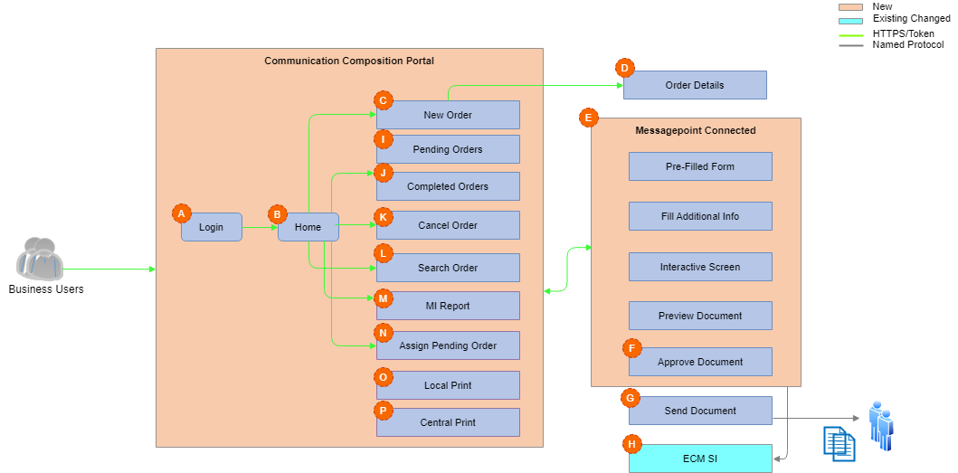
Appendix: Communication Composition Portal Flow – 1/2

Slide 82
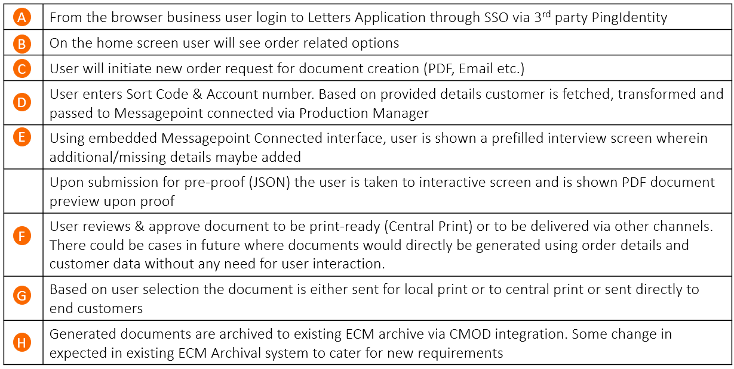
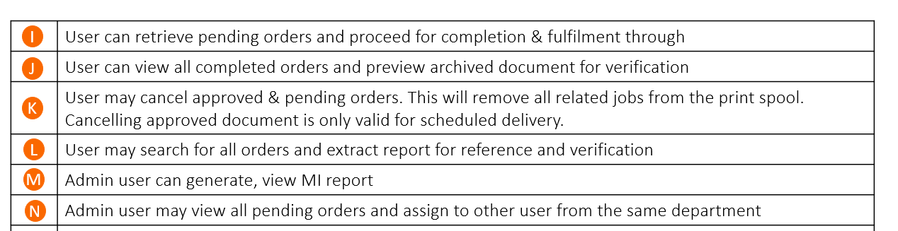
Appendix: Communication Composition Portal Flow – 2/2

Slide 83
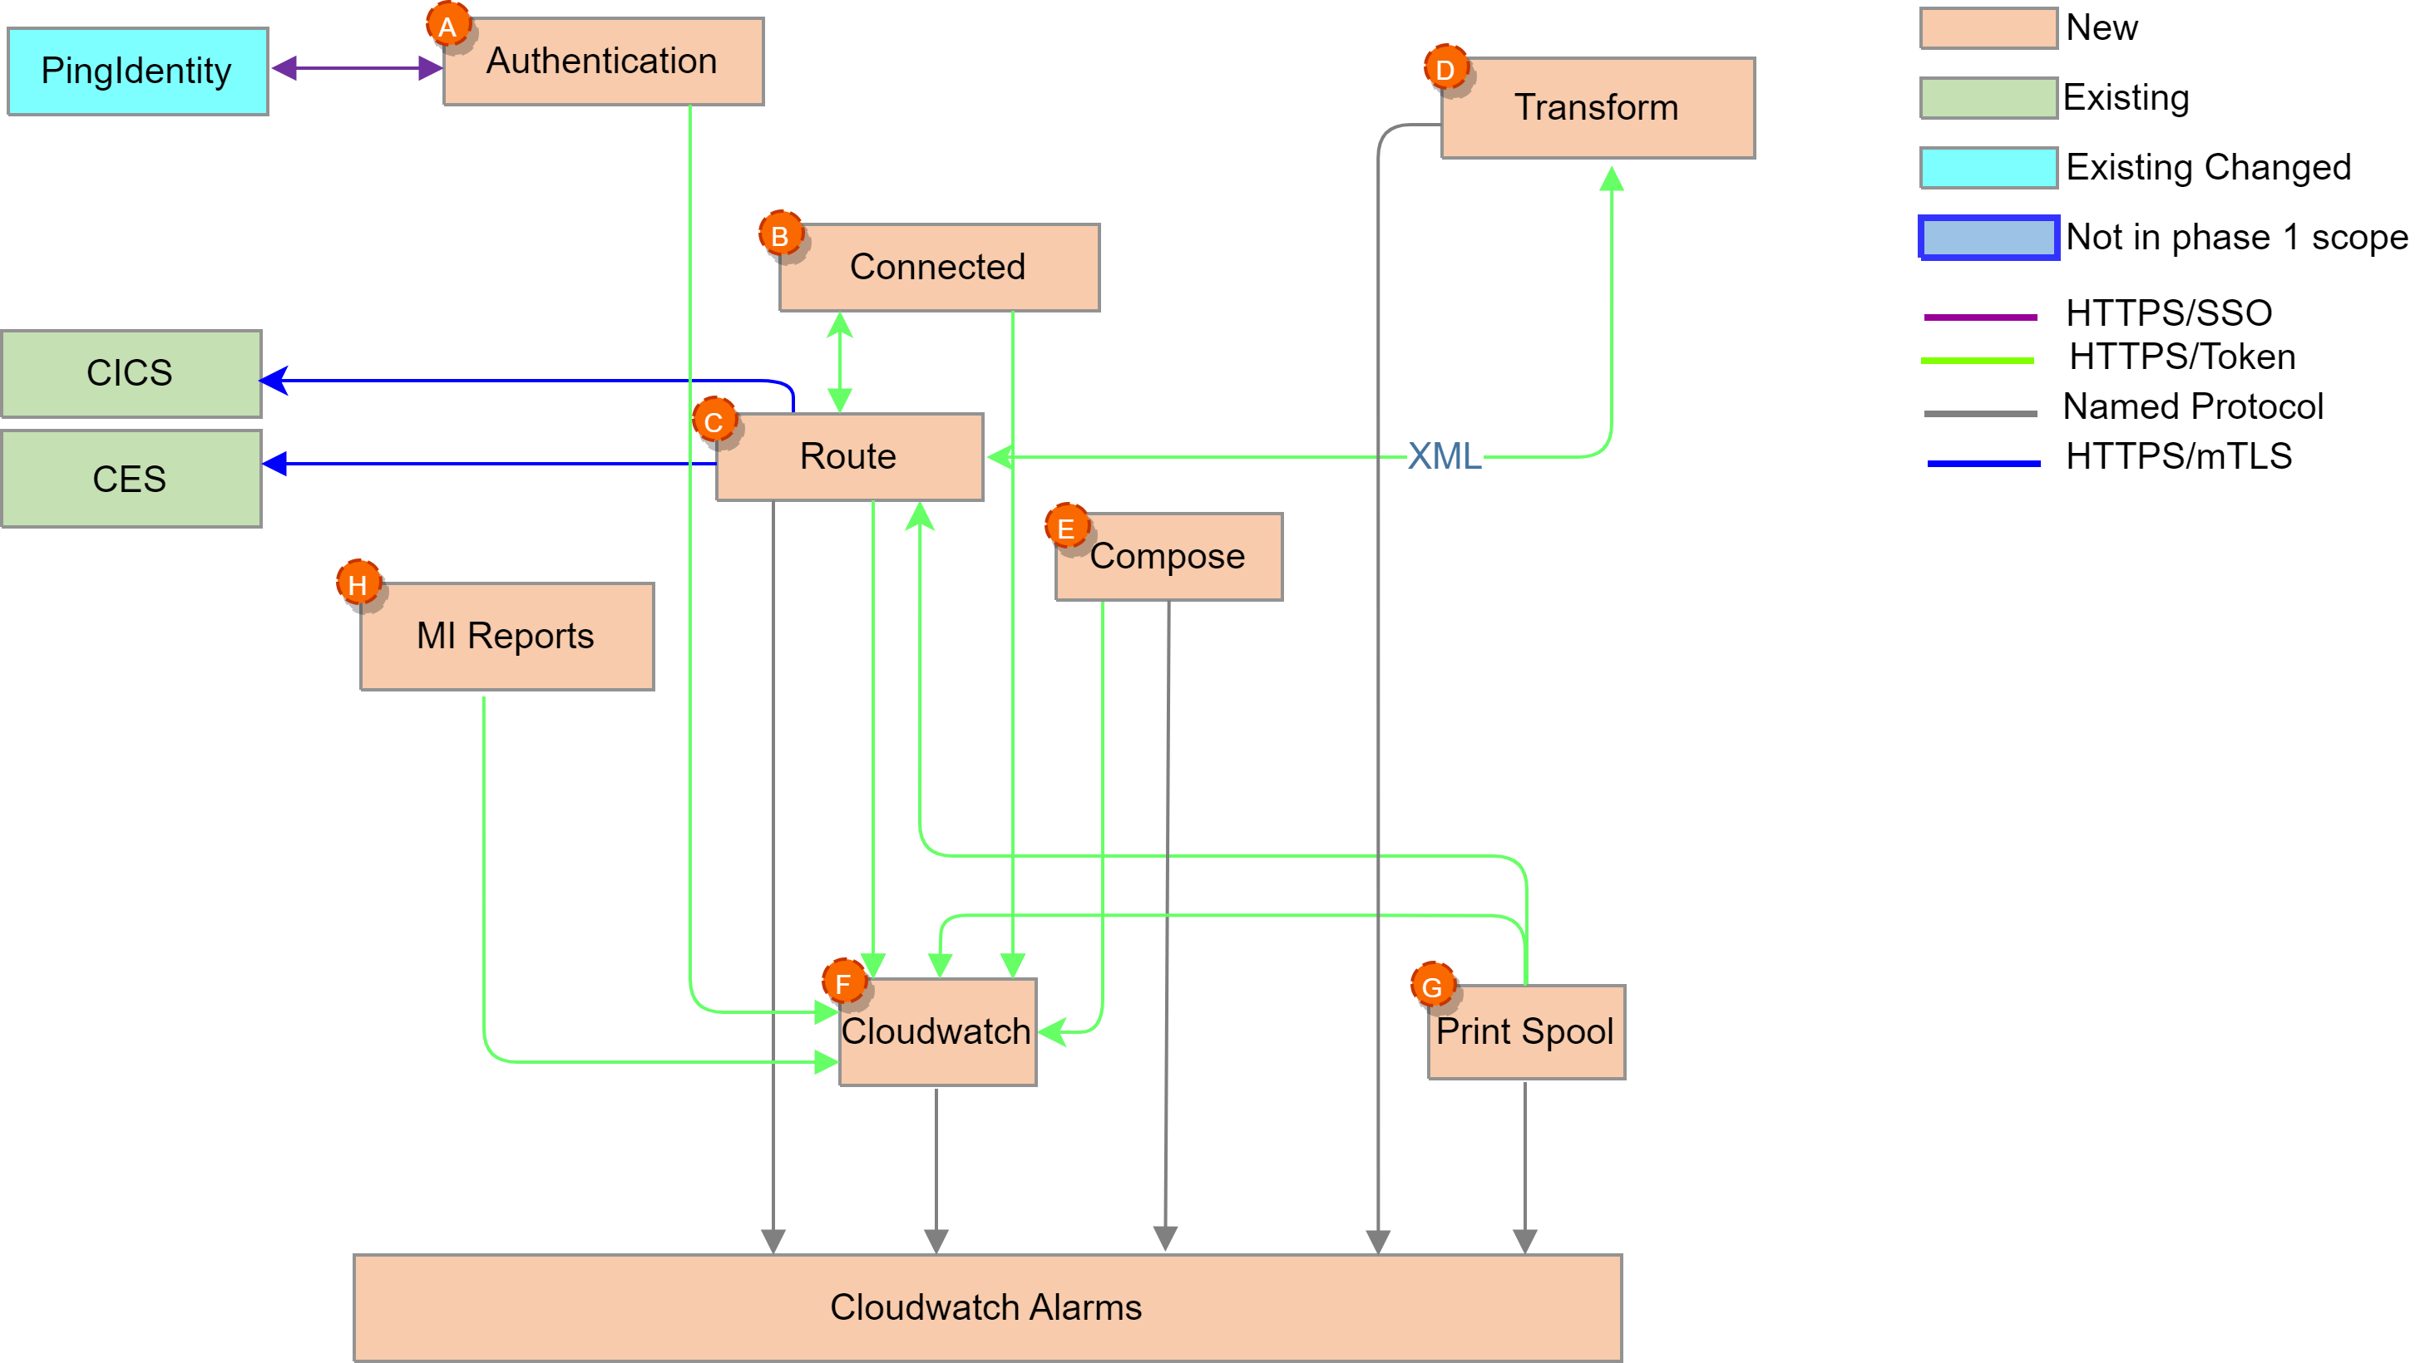
Appendix: Communication Services Flow – 1/2

Slide 84
Appendix: Communication Services Flow – 1/2
 | User logon to Communication Composition Portal (CCP) through SSO (setup in K8s via 3rd party PingIdentity). Single sign-on (SSO) uses central identity provider (IdP) to improve security by allowing users and teams to manage a single set of credentials
 | User enters Sort Code, Account number & Template Name in CCP and sends an order request. Based on order details, Connected service communicates with Route service to fetch customer data, transform and populate interview screen.
 | Route service uses Sort Code & Account Number and calls bank’s core API (CICS web-service) to Route to correct brand-based DB instance and fetch data (Customer address, postcode etc.) as XML. This data is passed to transform service for transformation, and returned to connected PAI to prefill MP interview screen Note: List of data fields is provided in low-level design
 | Transform service is used for data validation and utility functions from route service
 | Compose Service passes the request to view generated documents list for current date and for last 7 days. In further use-cases this can also be directly used for document generation from other business areas
 | Centralized logging is facilitated into the solution via CloudWatch. CloudwatchAgent & FluentBit Pods are deployed on each of EKS & ECS clusters to gather metrics and application logs and source to container insights.
 | Print Spool Service performs operation on print spool queue like deleting letter from queue, updated CCP audit DB & logging CES event
 | Generate MI report to log data in MI database
A
B
C
D
E
F
G
H

Slide 85
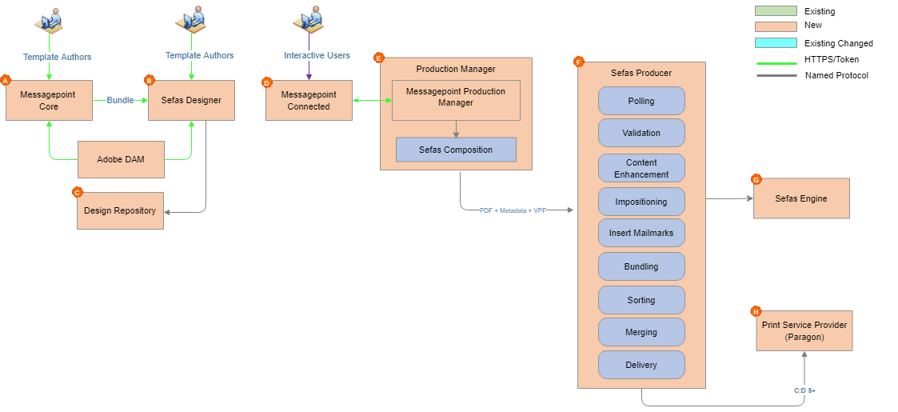
Design: Communication Composition Services Flow – 1/3

Slide 86
Design: Communication Composition Services Flow – 2/3
 | Developers use Messagepoint SaaS/Web based solution hosted in Messagepoint DC to design touchpoints, manage content & finalize touchpoints through inbuilt Sefas connector. The Messagepoint core instance may be synced with ADOBE DAM to reuse assets (images, fonts, etc..) during touchpoint creation. The touchpoint composition may have an optional approval process, if required.
 | Developers use on-prem Sefas HC designer to create Master Templates & Layouts. The approved design is stored into design repository
 | Design repository centrally manage templates, resources etc..
 | Business users logon to newly built CCP & create an order for correspondence using Messagepoint Connected.
 | Upon making all changes on an order, user sends the proof request and a PDF document is generated by Messagepoint Production Manager and rendered on connected. If the PDF copy is ok, the PDF maybe printed locally by the user. User may choose to send the document for fulfilment The fulfilment request bundle is used by Sefas engine to generate VPF output along with metadata into the spool directory (NAS storage). For central print VPF file along with metadata is generated
 | Sefas producer polls for generated copies of communication and handles the post-processing of documents & delivery to end-customers through Print Service Provider (PSP). Generated communications does not necessarily go through all steps depicted in the diagram instead only eligible steps are applied and communications are delivered. CACI will be used for mail sorting.
 | The VPF file is converted to AFP with TLE indexes after necessary post-processing using Sefas engine and submitted to print-provider for delivery to the customer. The list of files sent to PSP is maintained in the reconciliation database for reporting, & reprocessing.
 | PSP may generate file with list of all failed communications and pass back to be used for reconciliation at the reprocessing. Delivery of communication is maintained in communication tracking database for reporting or reprocessing purpose
A
B
C
D
E
F
G
H

Slide 87
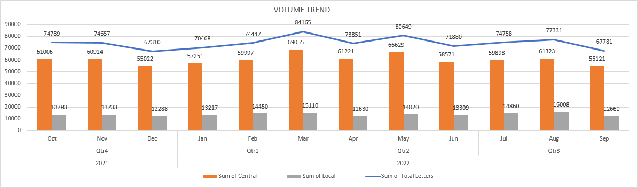
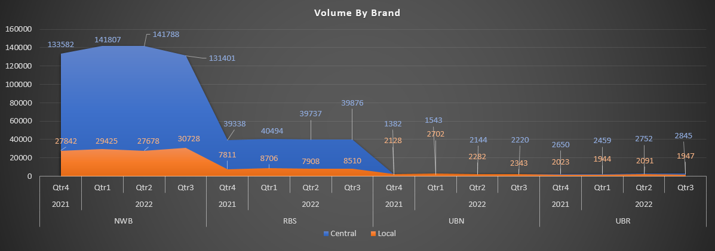
Capacity, Volumes & Performance
Where capacity requirements or volumes are significant, for example in registered users, transaction rates or database/file volumes for certain components of the system then this slide should be included and details completed in the table below.
Source: MI Report

Slide 88
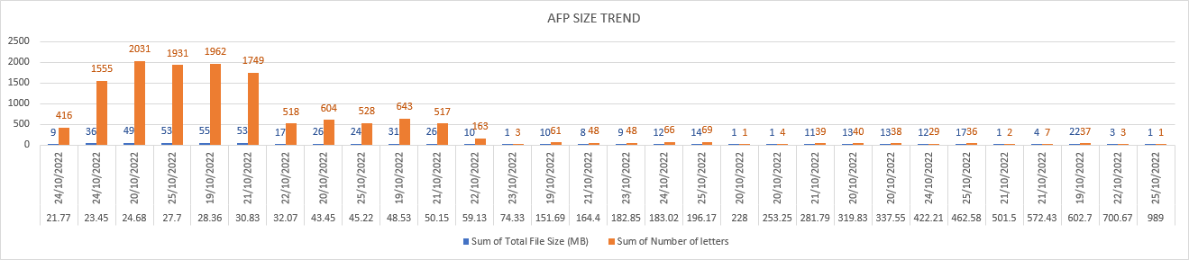
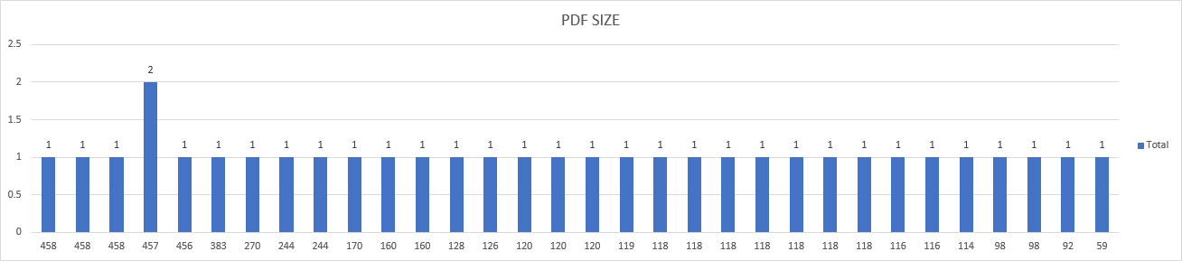
Capacity, Volumes & Performance
Where capacity requirements or volumes are significant, for example in registered users, transaction rates or database/file volumes for certain components of the system then this slide should be included and details completed in the table below.
Minimum AFP Size –21.77KB, Maximum AFP Size – 989KB, Average AFP Size – 235KB
Source: 10 days information from production/operations team
Minimum PDF Size –59KB, Maximum PDF Size – 458KB, Average PDF Size – 201KB
Source: Random production PDF sizes from Letters admin team

Slide 89
Appendix Phasing Overview - 1\3
Phase 1 | Phase 2
Ability to add inserts to letters at point of print for example physical leaflets, Business Reply Envelopes (BREs) Ability to apply digitised signatures to letters based on team selection Ability to easily add new brands in the future Difficulty for users when submitting a request to update letter as we require a document with clear instructions/tracked changes." We then need to create a set of similar but not identical templates to suit the business needing the changes Need to search in application across all templates and object for search parameter Ability to set headings in different fonts. Currently have to create image in Thunderhead Your Reference wording outputs even when no reference added by user Ability to recreate letters issued up to 7 years ago Ability to create new and update existing enclosures within tool Must be able to send letters to all current NatWest group brands (including legacy brands) Documents (templates, enclosures, imaged forms, shared content) to be version controlled with ability to view previous versions of all templates, enclosures, imaged forms and shared content for up to 10 years Print file format (AFP Advanced Function Presentation for central print, PDF portable document format for local)

Slide 90
Phasing Overview – 2\3
Phase 1 | Phase 2
Ability to use bank fonts to meet brand guidelines & Royal Mail requirement for customer mailing name and address section. Must apply to both PDF and AFP so must be capable of using different font types as needed. Output from different render formats must be identical. Ability to have multi-branded letter templates with built in embedded branded logic variables i.e. NOT one letter template per brand Must be able to handle multi-branded style sets Approval of documents before sending MI report on template output Production of 250k letters per month Central print dispatch at set time Drill down of templates Role based access Retrieve an archived document Retrieve a sent letter Audit trail on archive activity Audit trail per template created Save an archived document locally Scalable and flexible API for future changes Configurable TLE per template Attach an existing bank form Edit a saved and not completed letter

Slide 91
Phasing Overview – 3\3
Phase 1 | Phase 2
Error code documentation Test changes to templates by automatically outputting all possible variants Access to CCP application through Single Sign On Separate environments for testing Track changes to any template update Utilise a search function Clone and alter templates/business logic

